Slide 1
Washington’s labor market: outlook and resources
    Labor Market Information and Research
    Anneliese Vance-Sherman, Ph.D., Chief Labor Economist
    June 4, 2026
Revision date – Dec. 2025

Slide 2
Employment Security: Who We Are
Vision: Everyone in Washington has full access to the opportunities, power, and resources they need to flourish and achieve their full potential.
Mission: We contribute to healthy communities by providing people equitable access to resources that improve economic security.

Slide 3
Employment Security: What We Do
Unemployment Insurance
Provides weekly payments to people who are out of work through no fault of their own.
Paid Family and Medical Leave
Provides paid time off for people to care for themselves or someone with a serious medical condition or to bond with a new child.
WA Cares
Provides working people a way to access long-term care benefits when they need it.
Workforce Services
Provides employment and training services to job seekers and employers through the statewide WorkSource partnership.
Labor Market Information
Provides data and analysis of Washington’s employment conditions, economy, job market, and workforce.

Slide 4
Labor Market Information and Research
We are the official source of Washington state labor market information. We specialize in economic analysis, research, program and policy evaluation, and risk assessment. We produce, analyze and share quality information for decision making.

Slide 5
Using labor market information
Quantifying local economic drivers and trends
Workforce development
Economic development
Grant writing
Planning for the future
Wage setting
Generally knowing your local economic ecosystem
And more…

Slide 6
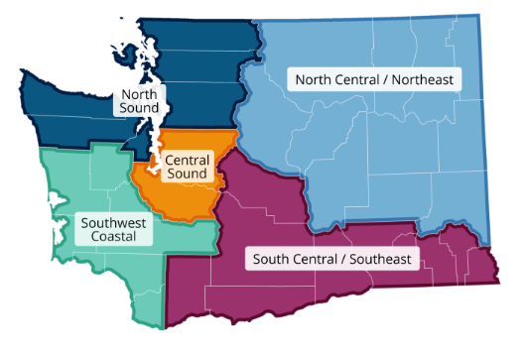
Regional Labor Economists
Your partner in local labor market information and analysis

Slide 7
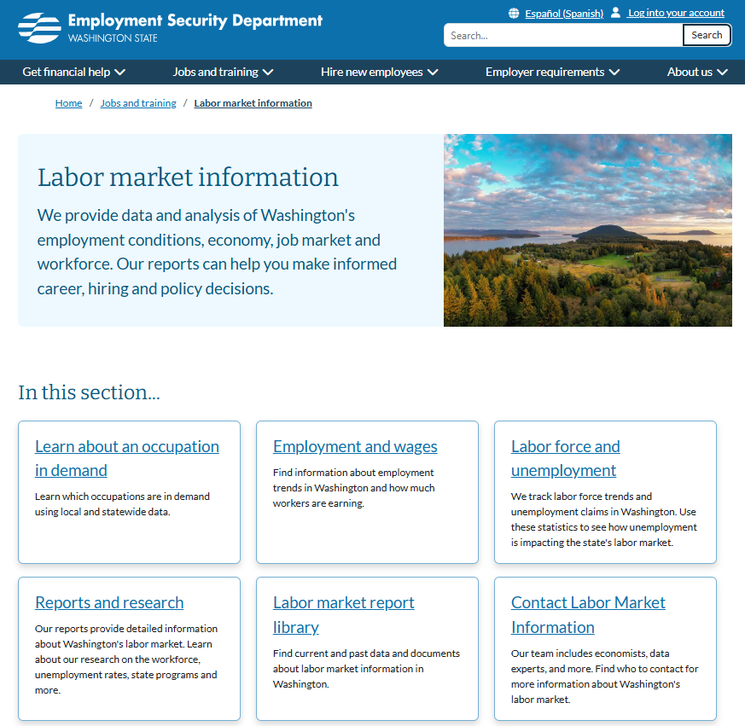
ESD.wa.gov
County Profiles
Employment estimates
Projections
Wages
Labor force and unemployment
Occupations in demand
Contact your economist
And more!

Slide 8
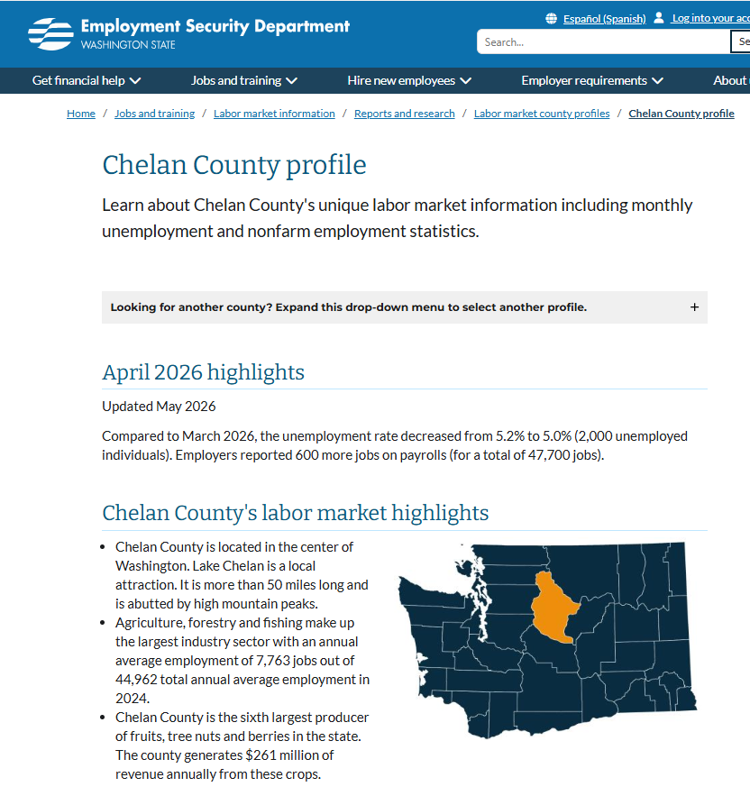
County Profiles
Labor market highlights
Unemployment and labor force
Monthly payroll trends
Industry and wage employment
Labor force and unemployment rate by demographics

Slide 9
Labor Force and Unemployment

Slide 10
The unemployment rate has been steadily increasing
April 2026 Unemployment rates
US: 4.3%
Washington: 5.2%
Seattle MSA: 5.5%
Notes:
Updated 5/30/26

Slide 11
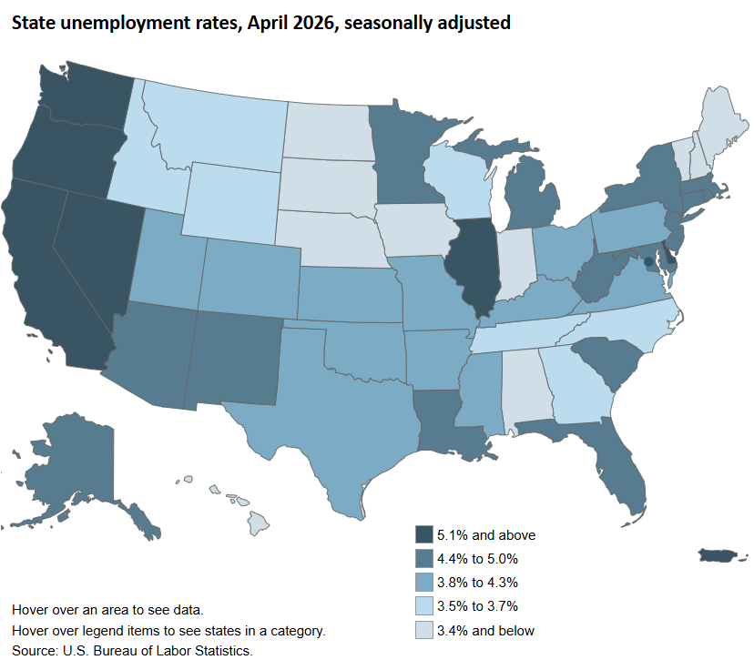
How does Washington compare to other states?
Highest rate: Washington, DC: 6.2%
Lowest rate: South Dakota: 2.0%
Notes:
Updated 5/30/26

Slide 12
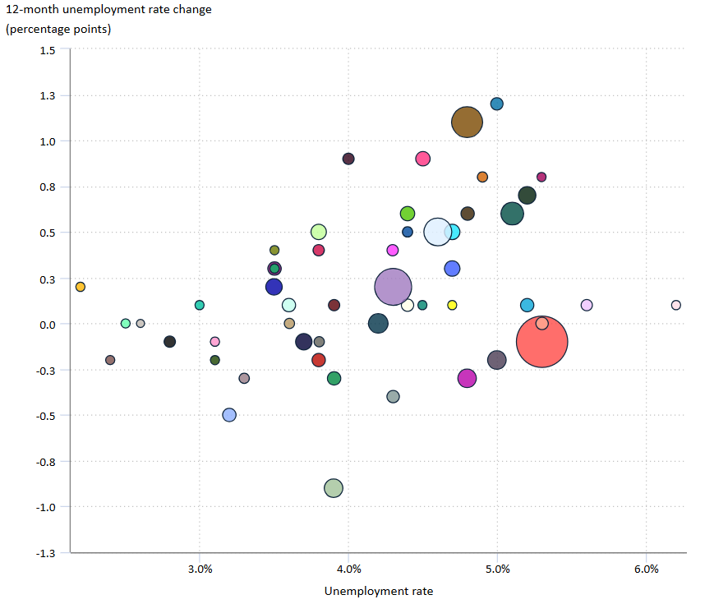
Washington’s unemployment rate has also increased faster than many states
Washington
12-month unemployment rate change: 0.7%
Unemployment rate: 5.2%
Number of unemployed: 212,533
States with the fastest growing unemployment rates: Connecticut and Florida

Slide 13
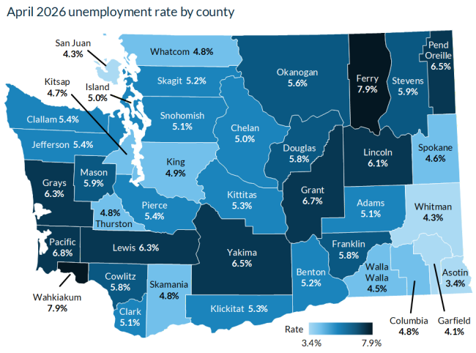
The unemployment rate varies throughout the state
Highest unemployment rate: 7.9% Ferry and Wahkiakum Counties
Lowest unemployment rate: 3.4% Asotin County
Seasonality is a major factor when looking around the state
Notes:
Updated 5/30/26

Slide 14
Labor Force Participation
Current labor force participation rate
US: 61.8%
WA: 62.5%

Slide 15
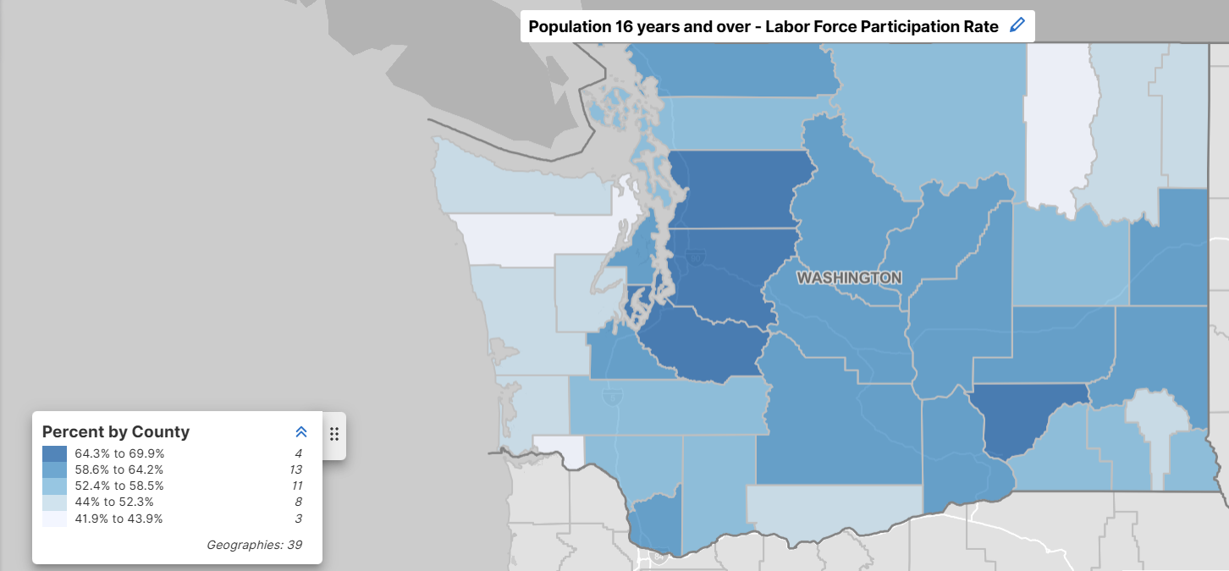
Labor force participation around the state

Slide 16
The unemployment rate is expected to remain low in the near future

Slide 17
Payroll employment

Slide 18
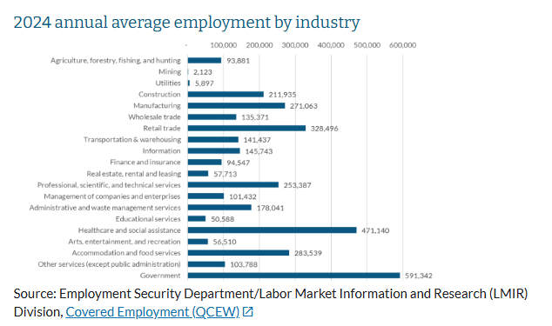
Washington’s employment ecosystem
Top 3 sectors by employment:
Government
Healthcare
Retail trade
Top industries by avg wage:
Total: $92,467
Management of companies $276K
Information $276K
Professional services $148K

Slide 19
Employment growth slowed in Washington

Slide 20
Washington employment lost momentum in 2025 /2026

Slide 21
Employment growth slowed and the unemployment rate has increased

Slide 22
Industry employment changes over the month
Total nonfarm | -3,200
Construction | 1,700
Wholesale trade | 800
Mining and logging | 200
Private education and health services | 100
Professional and business services | 0
Manufacturing | 0
Retail trade | -200
Transportation, warehousing and utilities | -400
Information | -500
Other services | -900
Government | -1,100
Financial activities | -1,200
Leisure and hospitality | -1,700

Slide 23
Industry employment changes over the year
Total nonfarm | 13,500 | 0.4%
Education and health services | 10,000 | 1.8%
Professional and business services | 7,700 | 1.4%
Transportation, warehousing and utilities | 7,100 | 4.6%
Leisure and hospitality | 3,200 | 1.0%
Information | 1,000 | 0.6%
Construction | 600 | 0.3%
Wholesale trade | 300 | 0.2%
Mining and logging | 200 | 4.1%
Manufacturing | -300 | -0.1%
Other services | -400 | -0.3%
Financial activities | -3,500 | -2.2%
Retail trade | -4,400 | -1.3%
Government | -8,000 | -1.3%

Slide 24
Industry employment trends, 2020 - 2026

Slide 25
Another (easier to read) view:

Slide 26
Around the state

Slide 27
Another (easier to read) view

Slide 28
Washington Economic Forecast calls for continued slow growth

Slide 29
Looking ahead
Tariffs / trade
International conflict
Price of oil
Inflation
Artificial Intelligence
Immigration policy
Etc…
Understanding your region can help you identify strengths and vulnerabilities. Labor Market data provides key local economic information.

Slide 30
Thank you!
Anneliese Vance-Sherman, Chief Labor Economist
  Anneliese.vance-Sherman@esd.wa.gov
Ajsa Suljic, South Central & Southeast Washington
Emily Robertson, Southwest Coastal Washington
Mike McBride, North Central & Northeast Washington
Paul Turek, Central Sound Region
Toby Paterson, North Sound Region

Slide 31
Equal opportunity statement
The Employment Security Department is an equal opportunity employer/ program. Auxiliary aids and services are available upon request to individuals with disabilities. We provide free help in many languages. People who need hearing or speech help can dial 711 for the Washington Relay.
El Departamento para la Seguridad del Empleo es un empleador/programa con oportunidades equitativas. Previa solicitud equipos auxiliares y servicios están disponibles para los individuos con discapacidades. Ofrecemos ayuda gratis en muchos idiomas. Las personas que necesitan ayuda para oír o hablar pueden marcar el 711 para comunicarse con el Servicio de Retransmisión de Washington.

