Slide 1

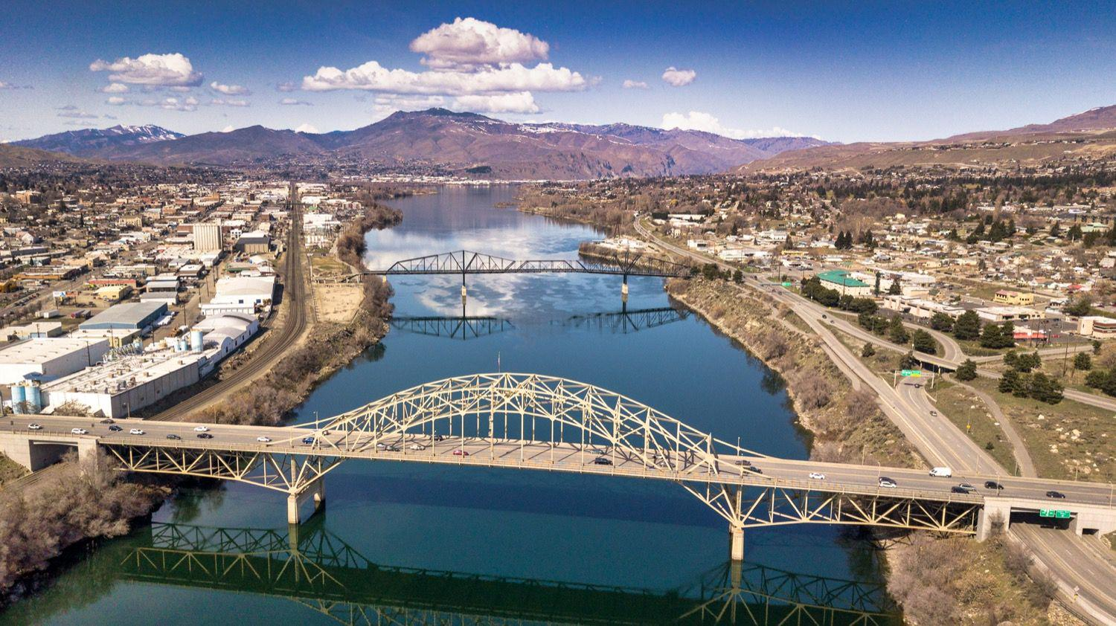
WCCE Annual Conference
The Role of Chambers in Washington’s Economic Future
  Kris Johnson| June 4, 2026

Slide 2
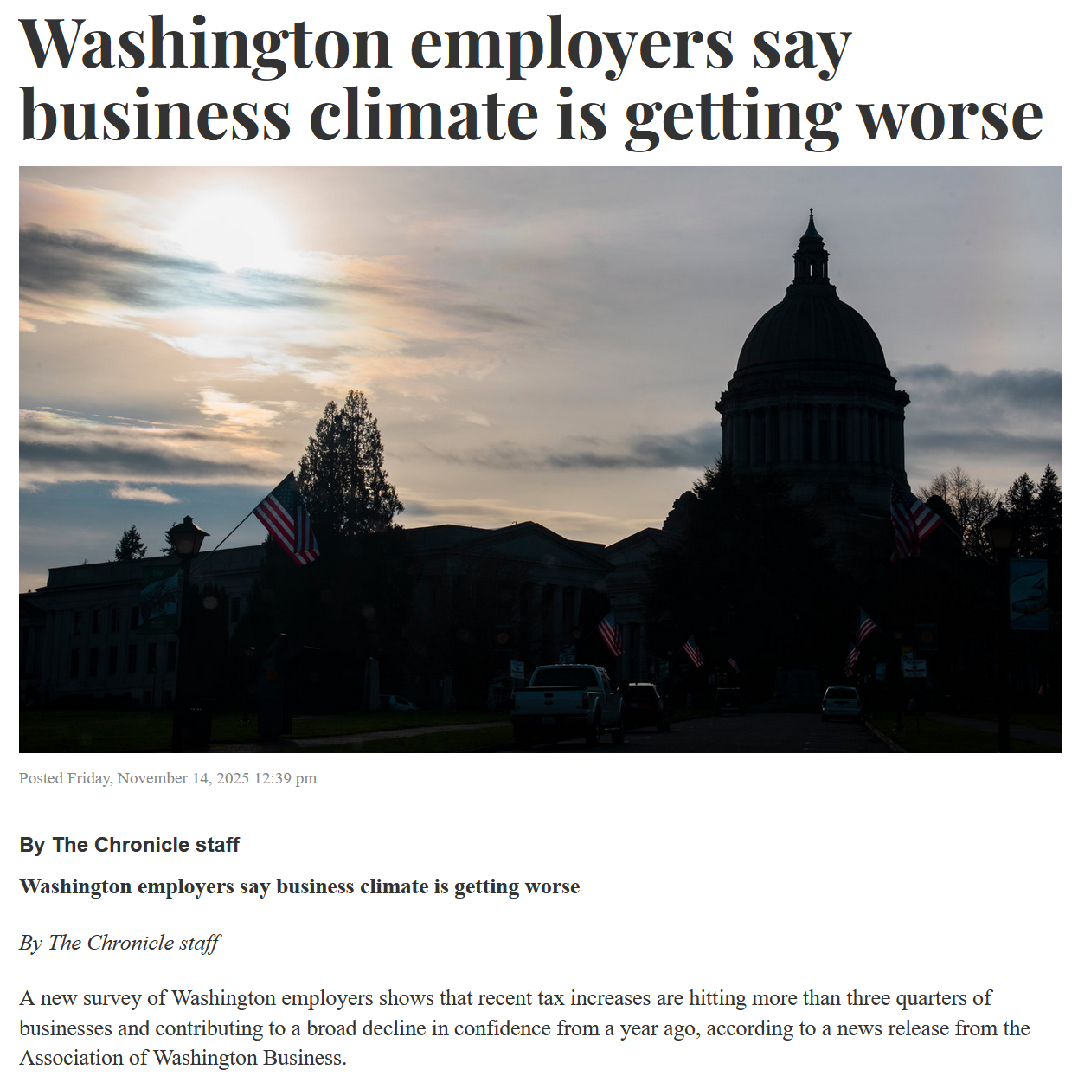
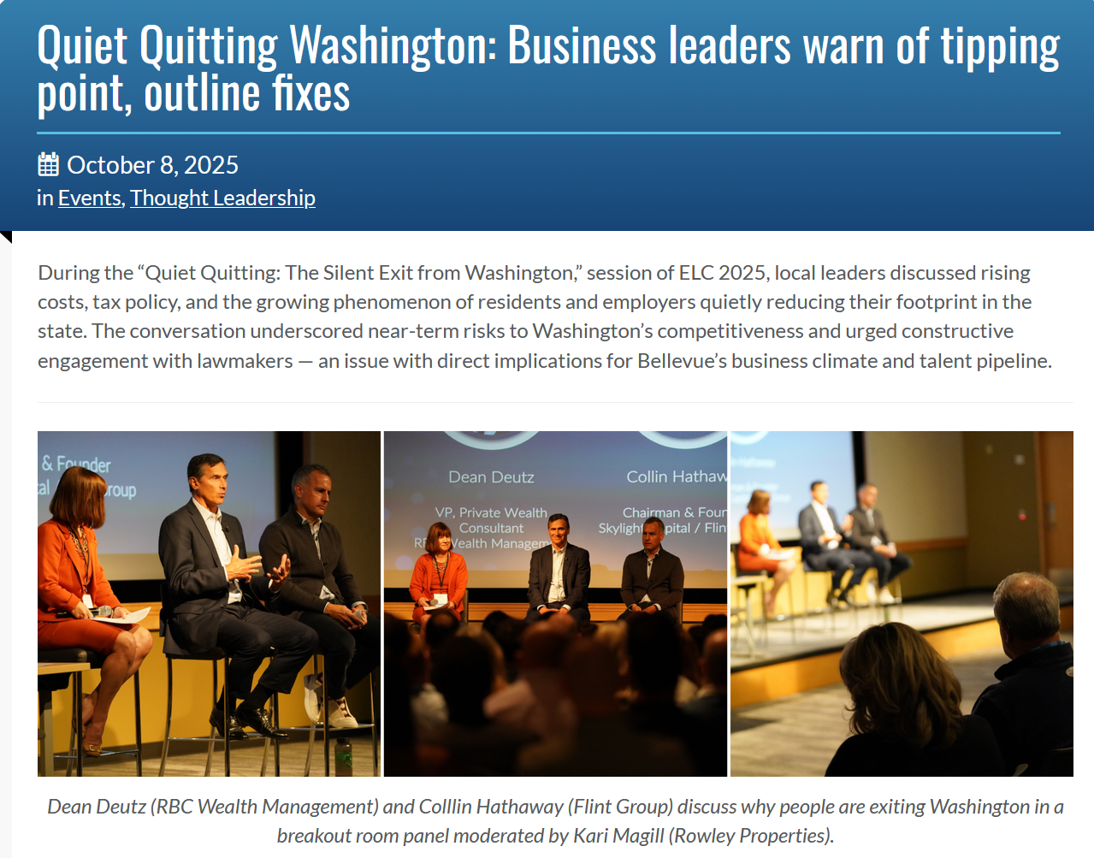
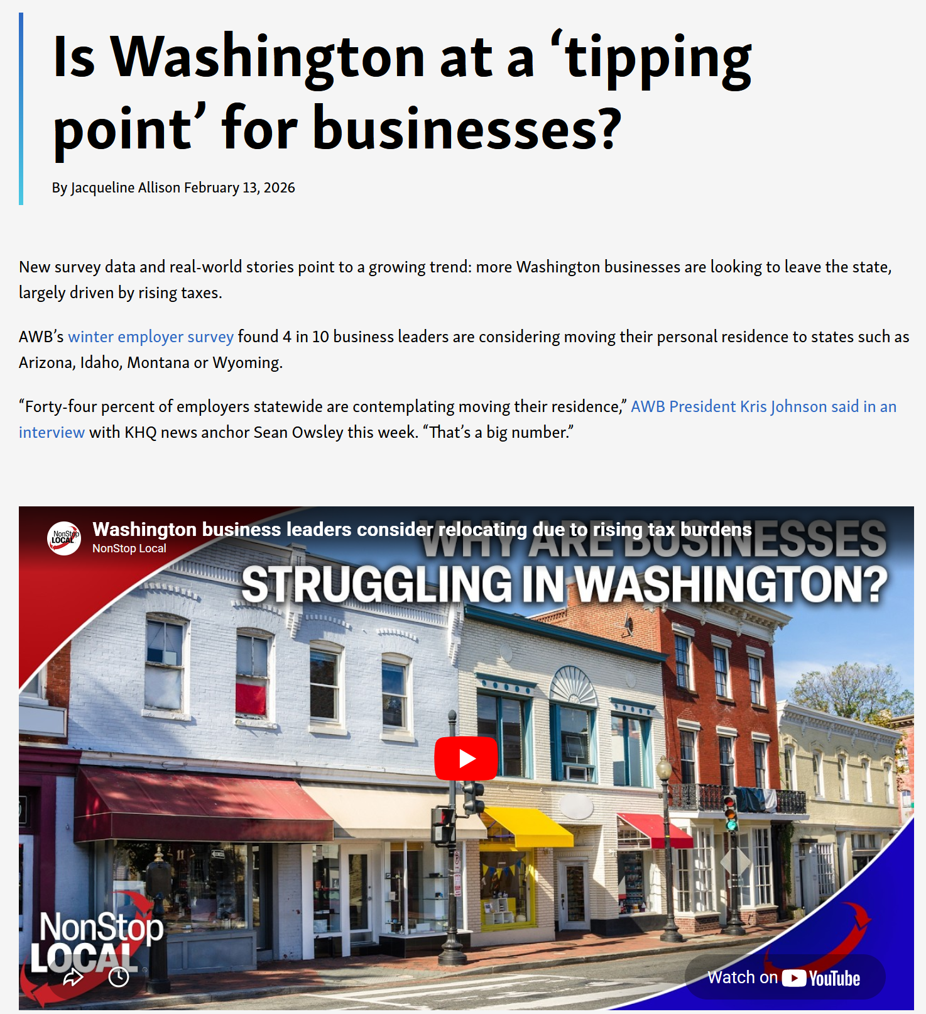
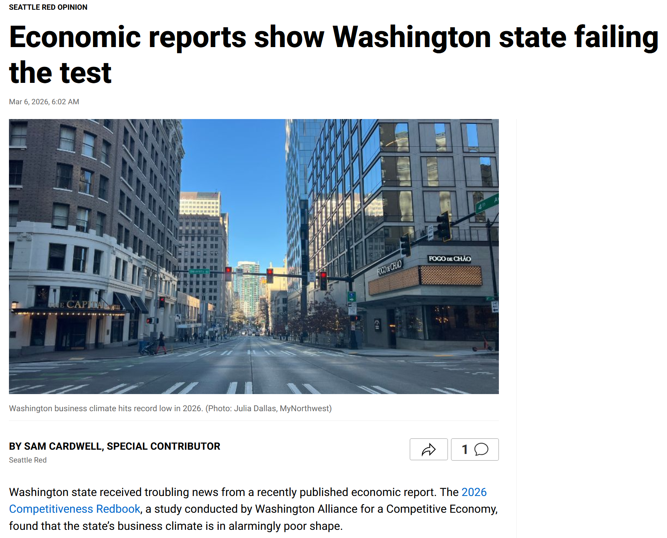

Slide 3
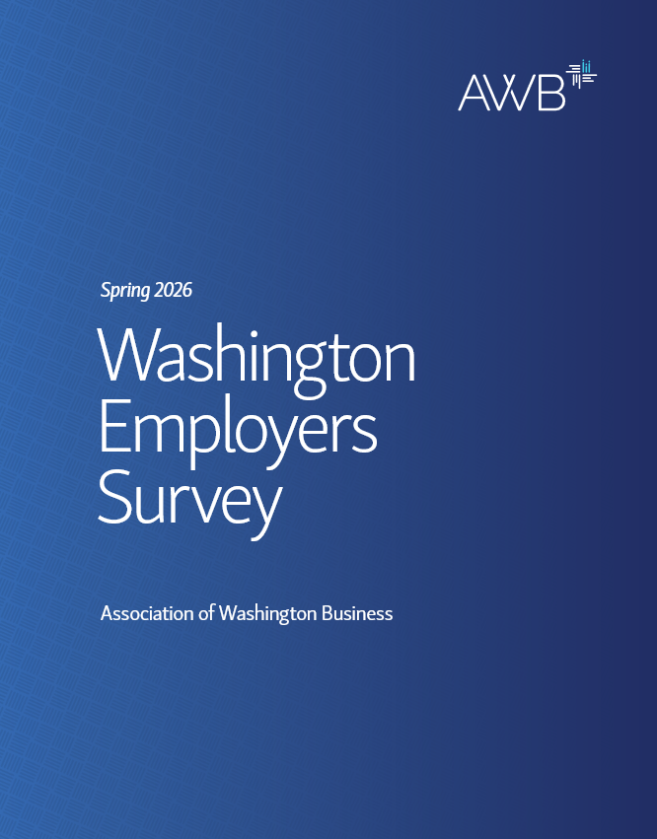
Sobering Survey
24% planning to relocate business
55% considering moving personal residence
Top reason – tax burden
Even higher in Spokane County
    31% - relocate business
    67% - relocate personal residence

Slide 4
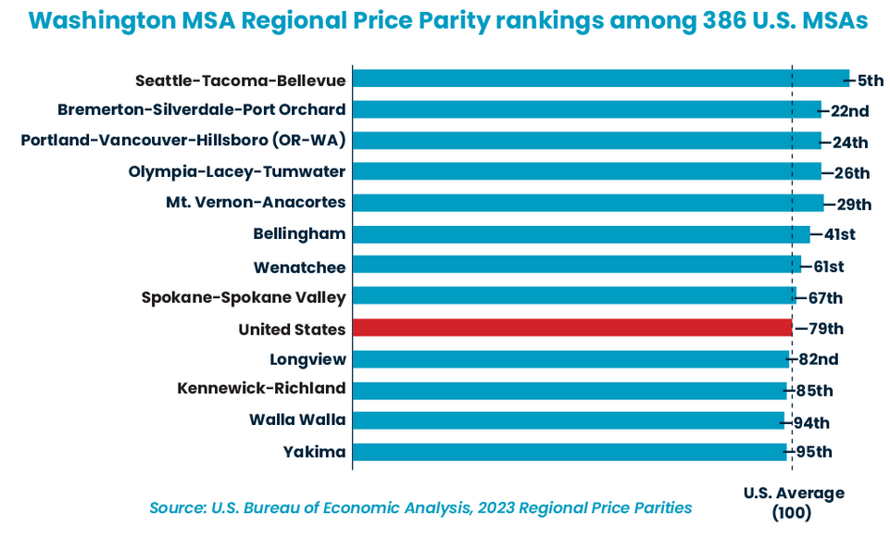
Affordability Crisis
Washington Roundtable study on affordability
WA is 5th most expensive place in the nation
Cost of living has increased faster than any other state in the nation
Statewide challenge

Slide 5
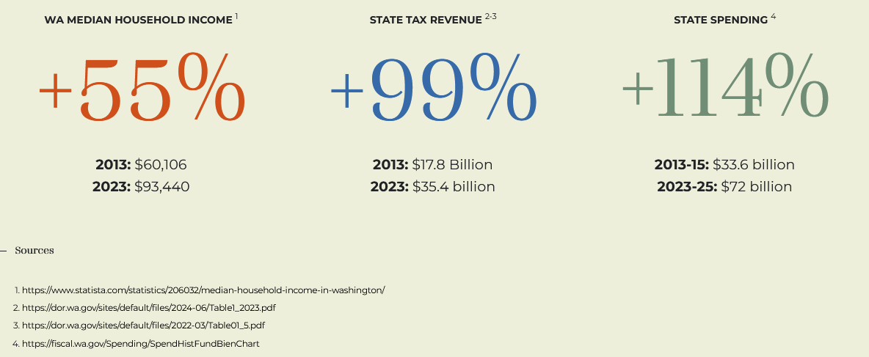

Slide 6
Industry Trends
Challenges for Chambers

Slide 7


State chambers, like other membership-based organizations, face a crisis
Who is moving
Notes:
In reality, it’s more like “Who is moving my cheese?”
How can we stay sustainable to fund our underlying mission?
How do we stay relevant to Gen Z?

Slide 8
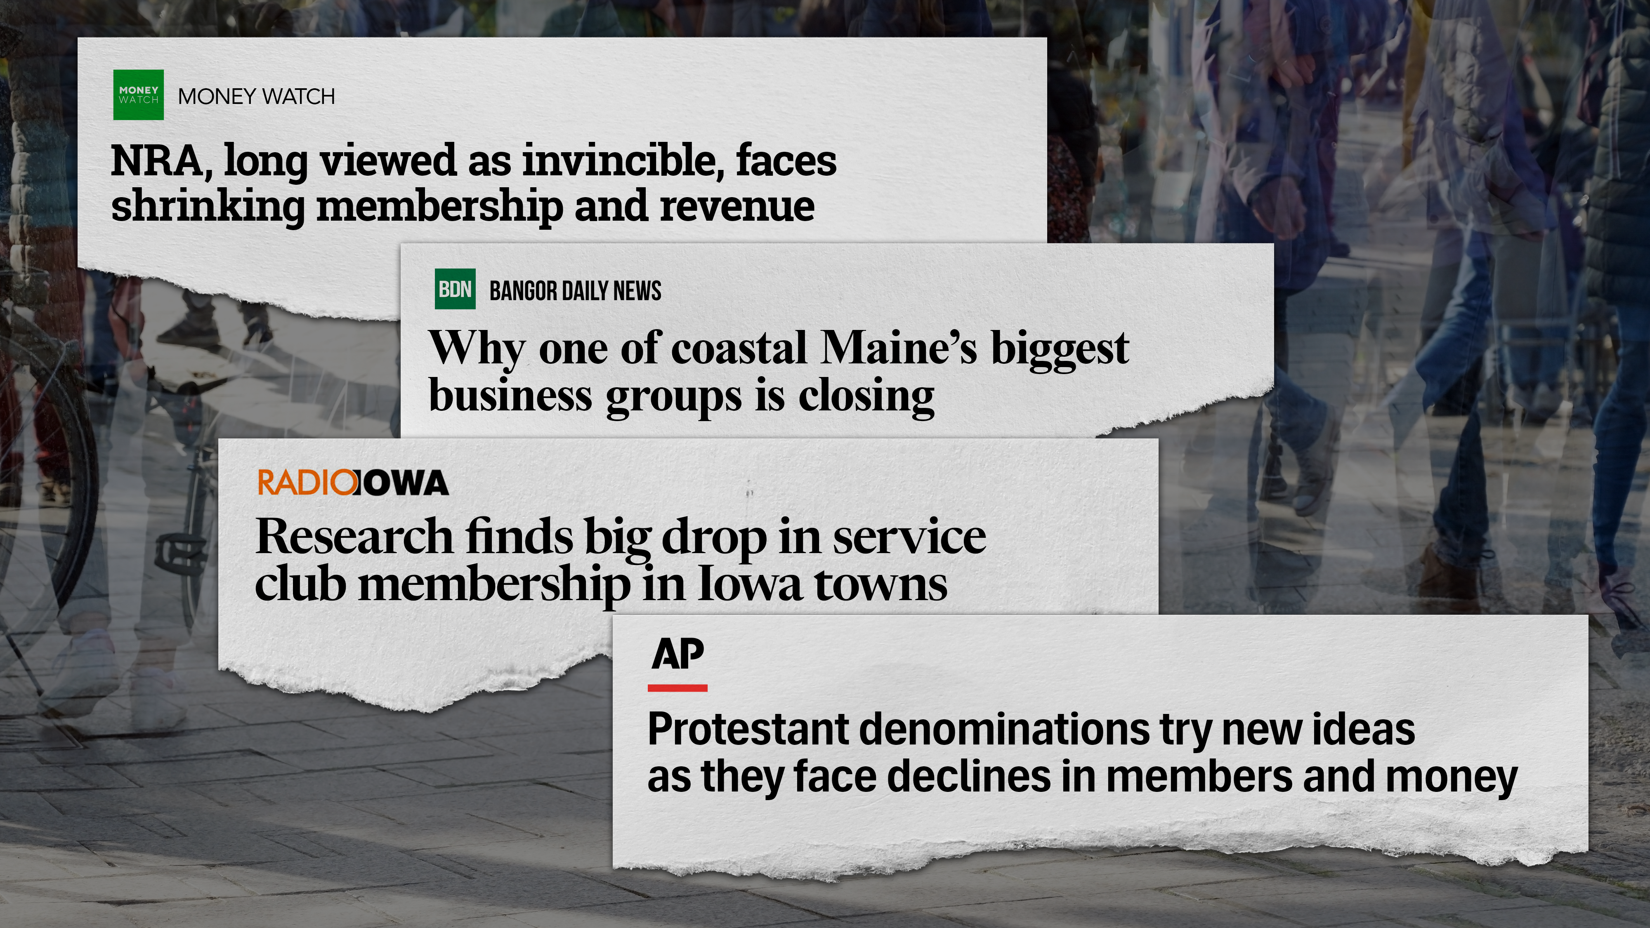

Slide 9

Membership growth is leveling out
In 2025, 45% of associations reported an increase in membership over the past year, and 26% reported a decline.
MGI 2025 Membership Marketing Benchmarking Report
“The member association model is fundamentally broken and outdated. We’re still running on an old model of “if we build it they will come.” We need to infuse a more innovative mindset into the association space, otherwise we will become obsolete.”

Slide 10



The three Ts
We’re all competing for time, talent, and treasure
Time is the most precious
Information overload and attention scarcity
We are not alone. Every member-based organization is experiencing this.

Slide 11
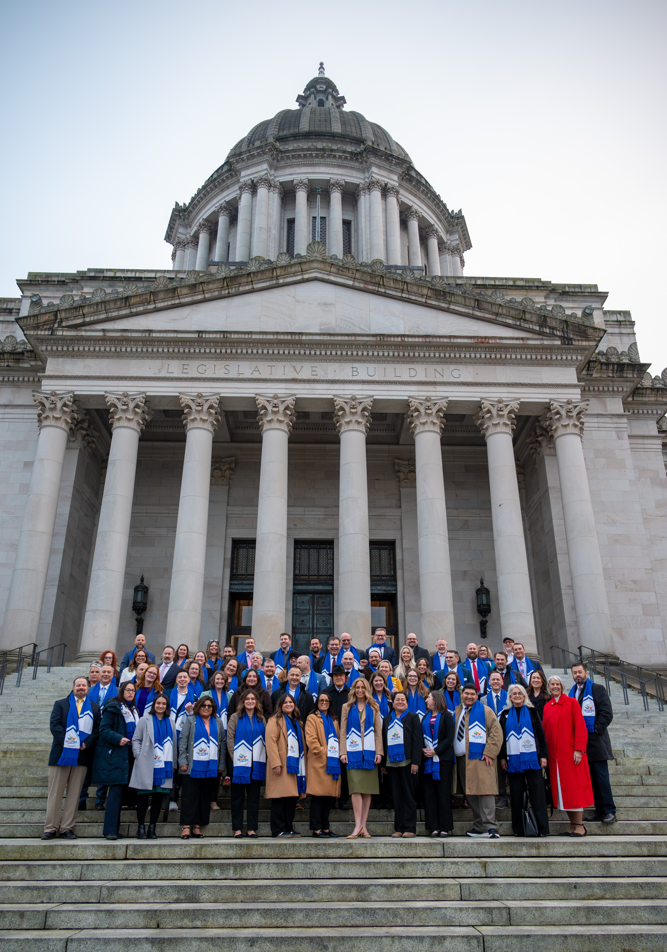
Our Role on the Field
Unmatched credibility
Personal relationships legislators can’t ignore
If not us, who?
Business owners expect their chambers to defend them when it counts

Slide 12
What We’re Doing
AWB and Employer Community Response

Slide 13
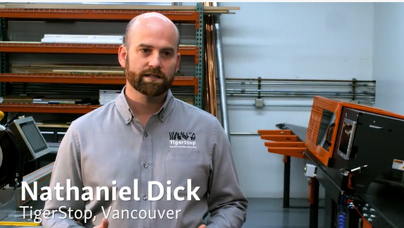
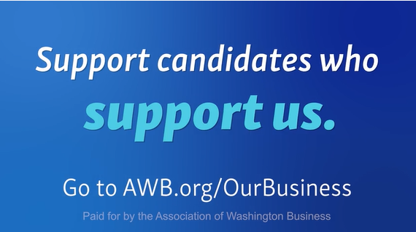
It’s Our Business
Too few legislators with business experience
Don’t understand impact of their policy choices
Encourage local business leaders to consider running for office
Support candidates who support us

Slide 14
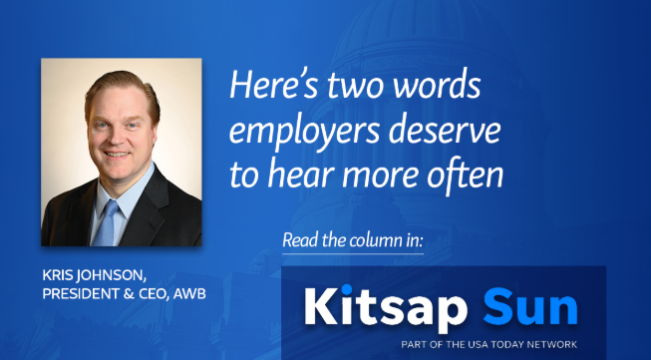
Thank You
Recognize and elevate Washington employers for the role they play in the state’s economy, communities and culture
Acknowledge these contributions are often unrecognized
Why it’s important to say “thank you”
Establish the connection to the need for a long-term statewide economic development plan

Slide 15
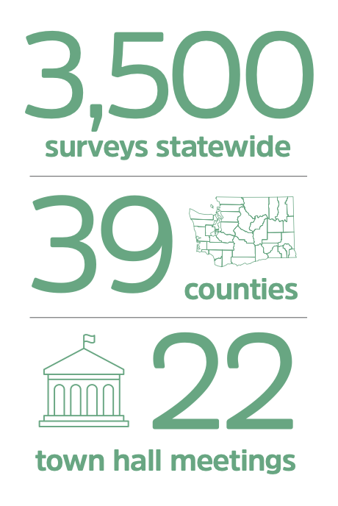
Washington in the Making 2040
15-year economic vision for Washington
Built by and for Washingtonians
Focused on shared values and a proactive road map
Launched June 2025
Solutions Summits
    October 2025 : Energy
    July 16: Economic Future

Slide 16
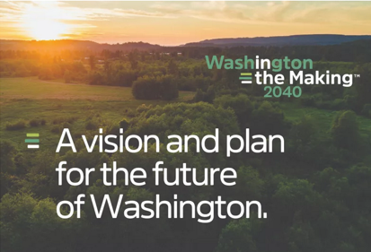
How the Plan is Landing
100+ employers and community leaders at June launch
Strong engagement from energy, manufacturing, ag and tech sectors
Chambers across the state using the framework with their members
Gov. Ferguson and Legislature taking note
Gives employer community a proactive agenda

Slide 17

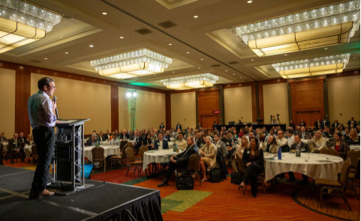
Energy Sector Momentum
Energy Solutions Summit launched a serious statewide conversation on energy supply and reliability
Focused on generation barriers, transmission bottlenecks, regulatory reform
Emerging innovations: SMRs, hydrogen, carbon capture

Slide 18

Economic Future Solutions Summit
July 16 – SeaTac Hilton
Your community needs to be in the room
Relocation is real
Sends a signal this isn’t just a Seattle/Puget Sound issue
Collaborate to build a local plan

Slide 19
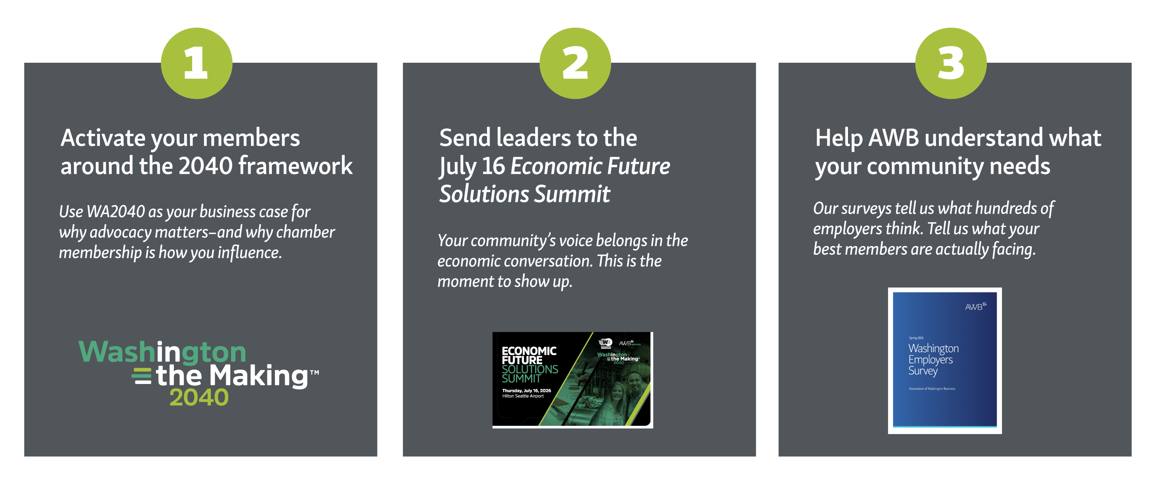
Three Ways Your Chamber Plugs Into the Plan

Slide 20
email@awb.org /

