Slide 1
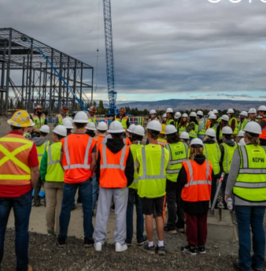
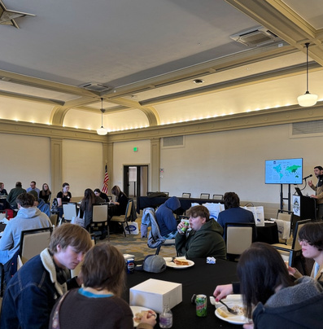
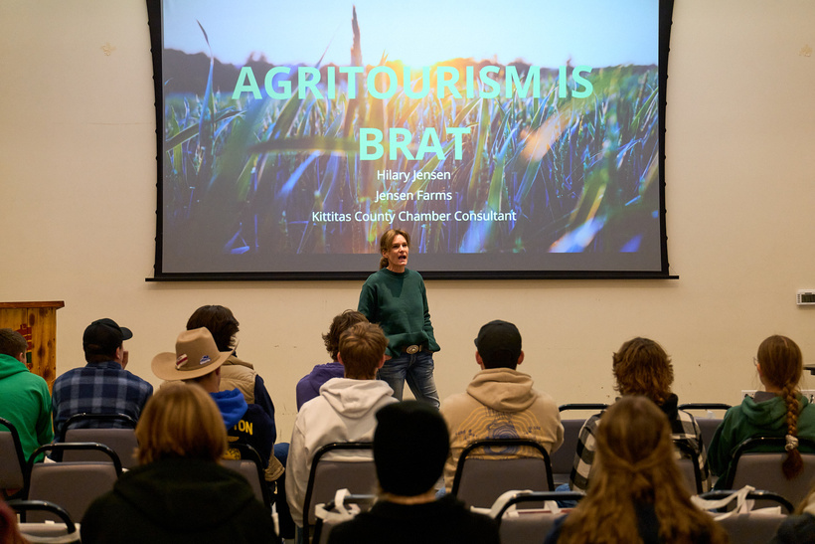
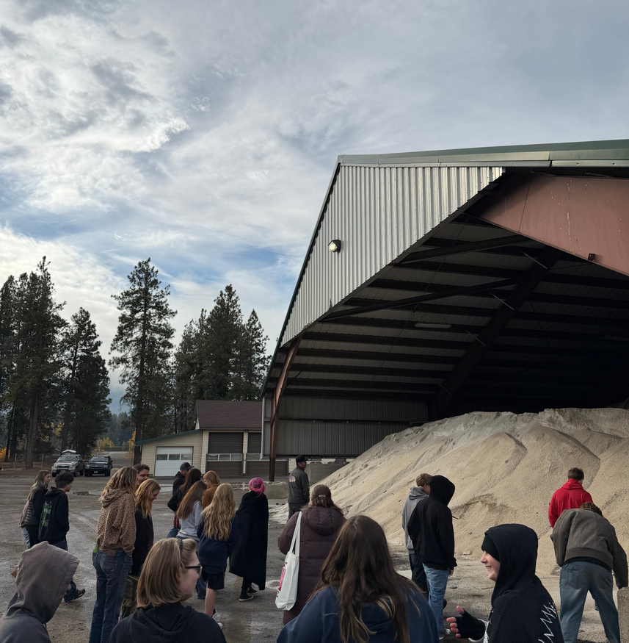
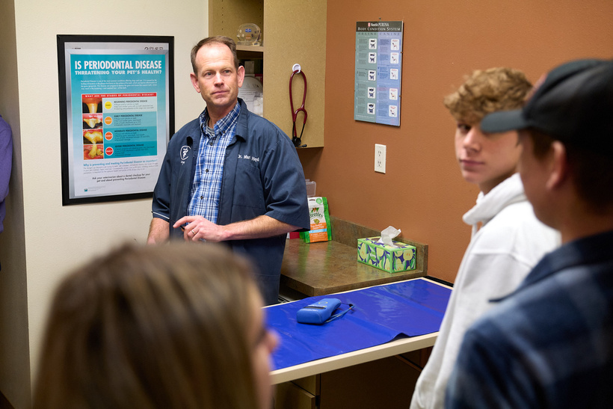
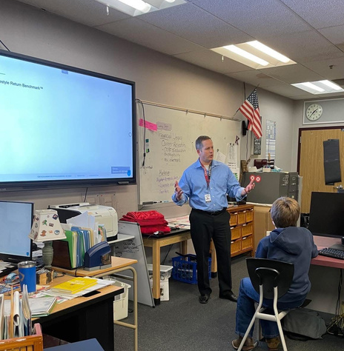

2022-2026
Kittitas County
Youth Programming
PRESENTED BY
amy mcguffin, ceo

Slide 2
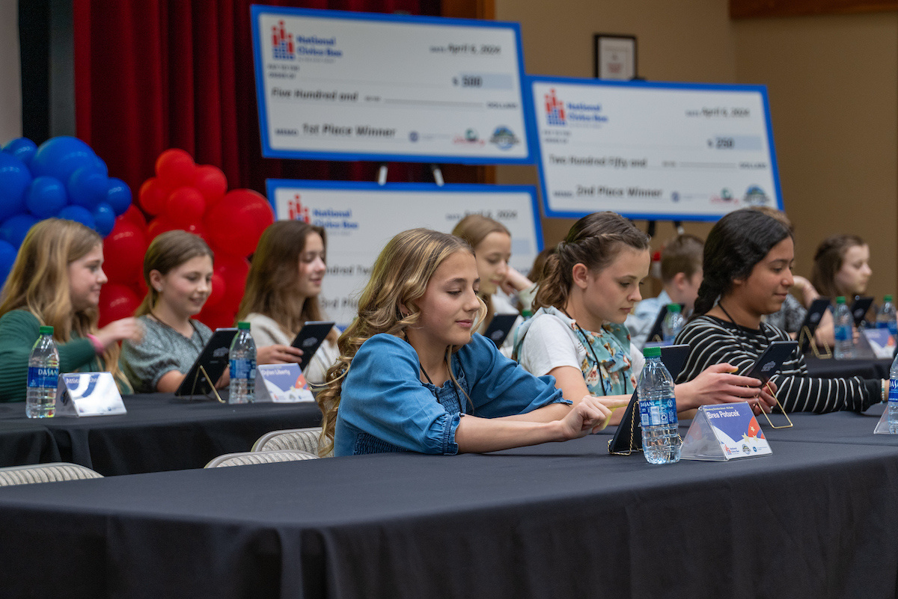
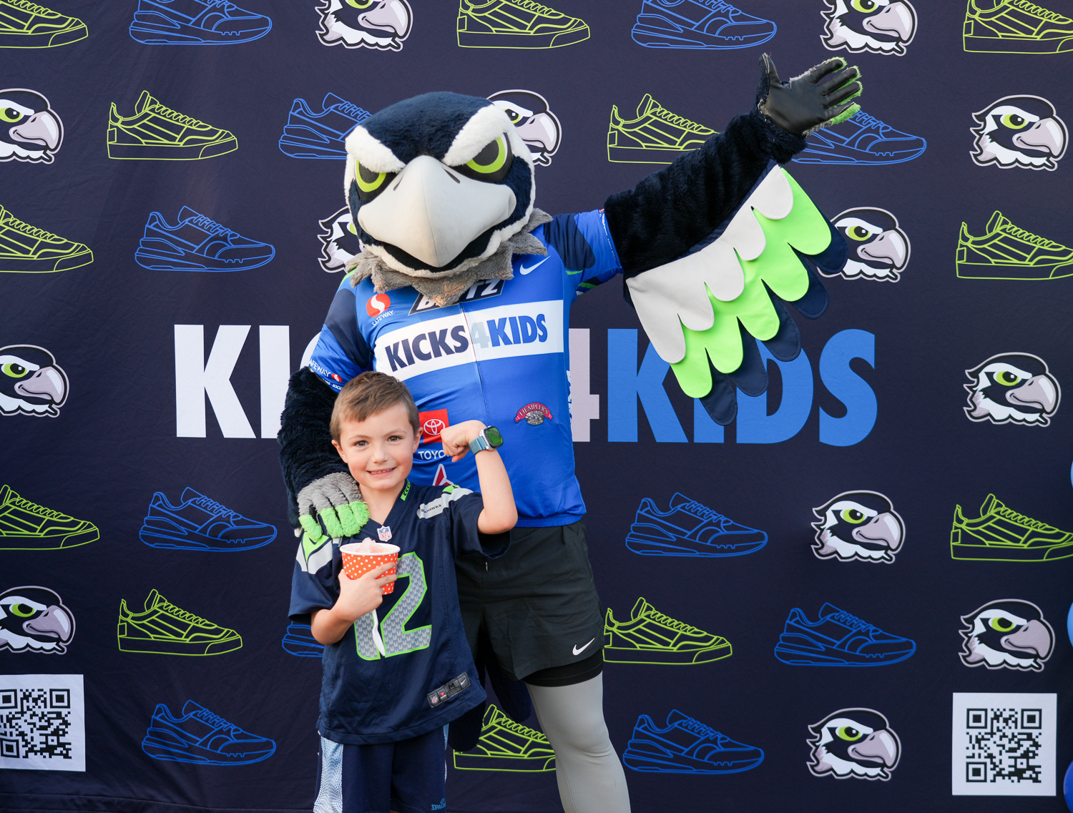
Aligning With
Chamber Mission
Starting in 2022 we introduced youth events to Kittitas County dipping our toes in the water surrounding our youth.
Focusing on workforce development in Kittitas County and within that creating a quality place for everyone to live, work and thrive here not only with our businesses --- but educating and equipping our youth.
We want students to grow up here and love where they live, providing opportunities right in their back yard to graduate and pour back into the economy and not move away for “bigger and better” jobs.
National Civics Bee Regional Competition 2024, Kicks4kids Seattle Seahawks Blitz Fundraiser 2025

Slide 3
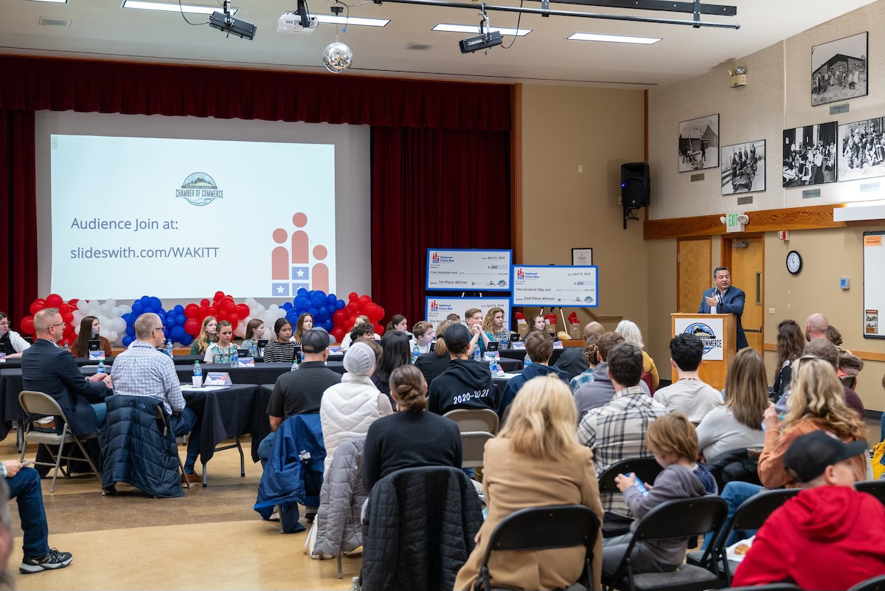
Events Timeline
LEMONADE DAY (K-5)
  (CANCELLED IN 2024)
2022
  NATIONAL CIVICS BEE COMPETITION (6-8TH)
2023
  AGRICULTURE YOUTH SUMMIT (11-12TH), KICKS4KIDS FUNDRAISER
2024
  HOSPITALITY & TOURISM YOUTH SUMMIT, CONSTRUCTION YOUTH SUMMIT, INTERNSHIP FAIR @ BIG PICTURE
2025
2026
MARKETING & AI YOUTH SUMMIT
  WSECU REALITY DAY
ALL WHILE SUPPORTING SCHOOL DISTRICTS
  THROUGH FIELD TRIPS AND GUEST SPEAKERS
  = 4 YOUTH SUMMITS, 1 NATIONAL PROGRAM, 1 INTERNSHIP FAIR, 1 FINANCIAL LITERACY

Slide 4
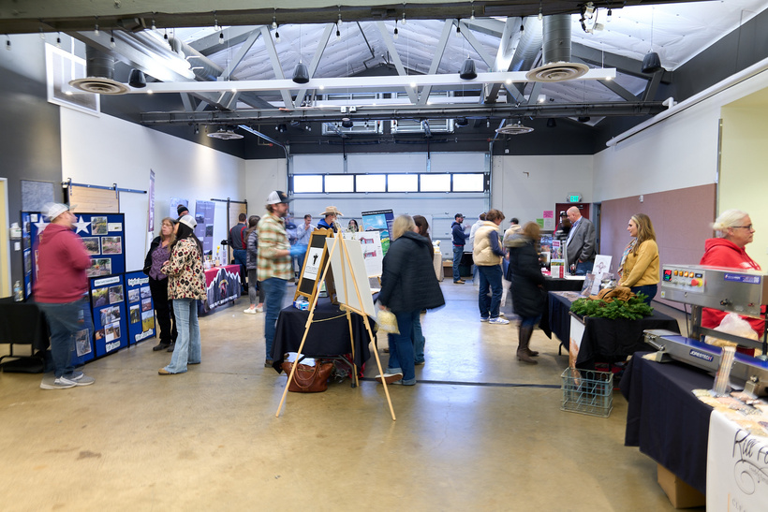
2024
  Agriculture Youth Summit
  ELLENSBURG, WA
Date: December 1, 2024
Locations:
The Armory at Kittitas Valley Event Center
Valley Veterinarian and Boarding
Welcome Message Video: Congressman Dan Newhouse
Total Industry Speakers: 2 (Vets on the Farm & Jensen Farms)
Total Trade Show Booths: 21
Total Attendance: 42
Breakdown of Attendees:
Ellensburg = 15, Thorp = 14, Cle Elum/Roslyn = 7, Chaperones = 6 & Staff
  Lunch Keynote: Dru Ernst, with Dru Bru Brewery and Taproom

Slide 5
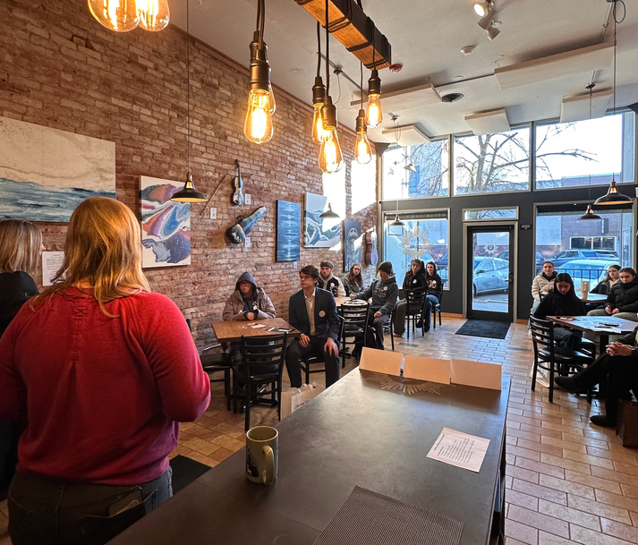
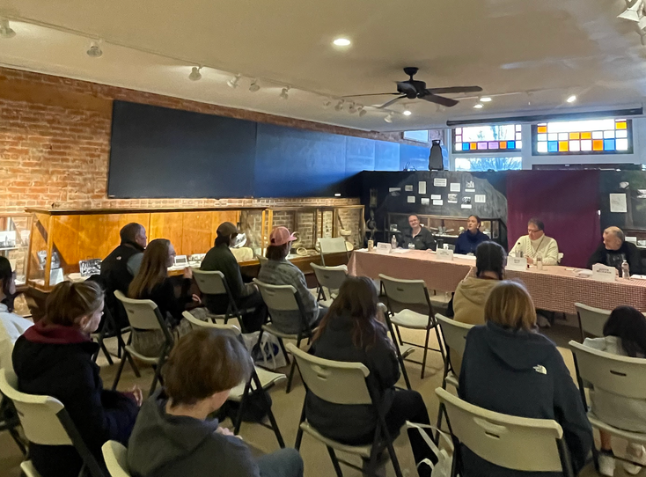
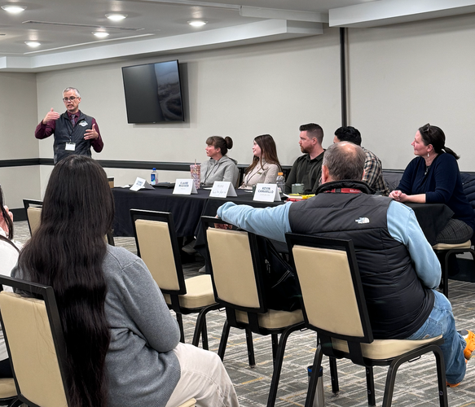
2025
  Hospitality and Tourism Youth Summit
  ELLENSBURG, WA
Date: January 29, 2025
Locations:
Hotel Windrow (2 breakout rooms)
Valo Tasting Room
Kittitas County Historical Museum
Welcome Message: Kittitas County Commissioner Laura Osiadacz
Total Industry Speakers: 15
Total Attendance: 56
Breakdown of Attendees:
Ellensburg = 26, Thorp = 19, Kittitas = 3, 6 Adult Chaperones
  Lunch Keynote: Matthew Ozuna, State of Washington Tourism

Slide 6

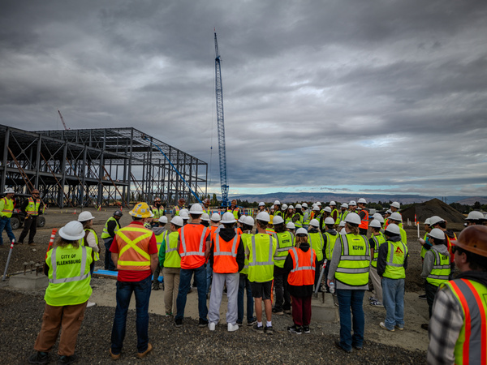
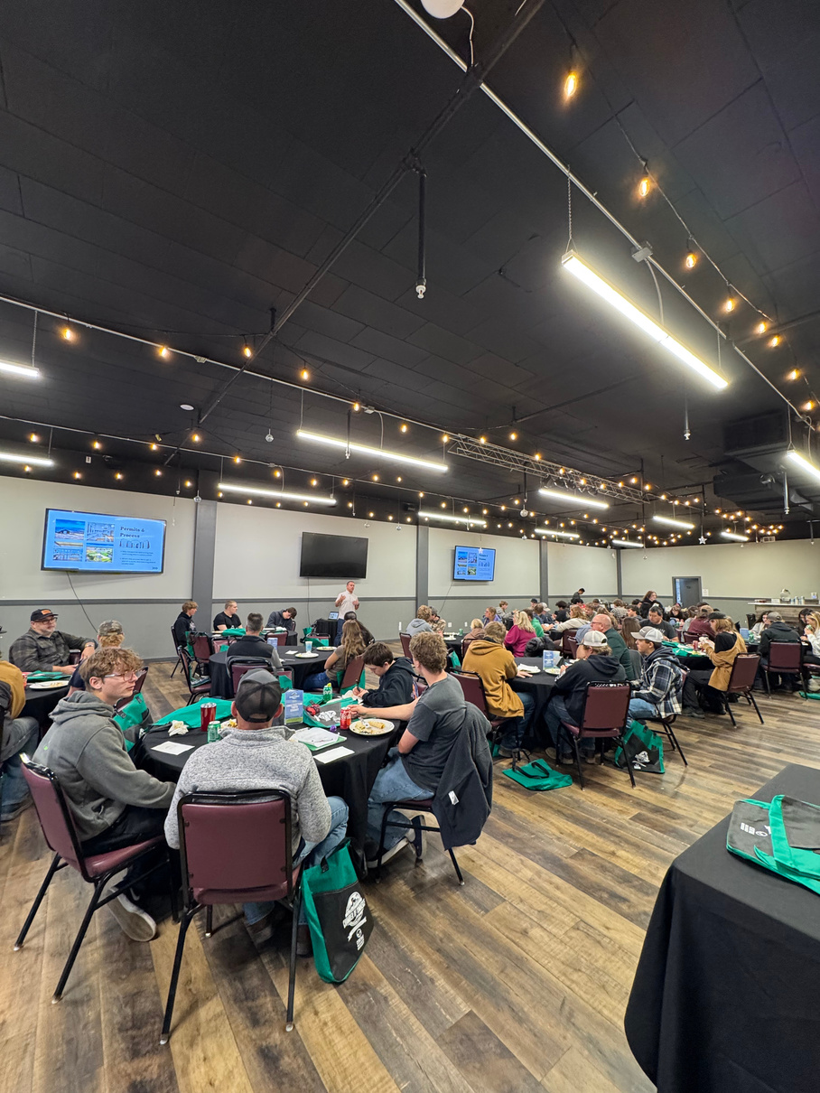
2025
  Construction Youth Summit
  ELLENSBURG, WA
Date: October 1, 2025
Locations:
Hotel Windrow
WINCO Foods Construction Site
Kittitas County Historical Museum
The Ridge Encore Event Center
Welcome Message: CWU Director of City Planning, Delano Palmer
Total Industry Speakers: 9
Total Attendance: 73
Breakdown of Attendees:
Ellensburg = 10, Christian = 11, Thorp = 23, Kittitas = 1,
Cle Elum/Roslyn = 14, CWU = 6, & City of Ellensburg Staff and Chamber Staff
  Lunch Keynote: David Chamberlin, Coldwell Banker Central & Celina Sanchez/Sarah Patterson AGC of Washington

Slide 7
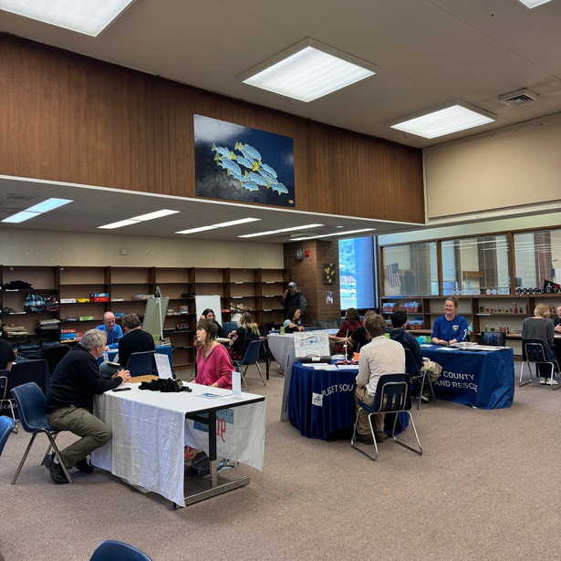
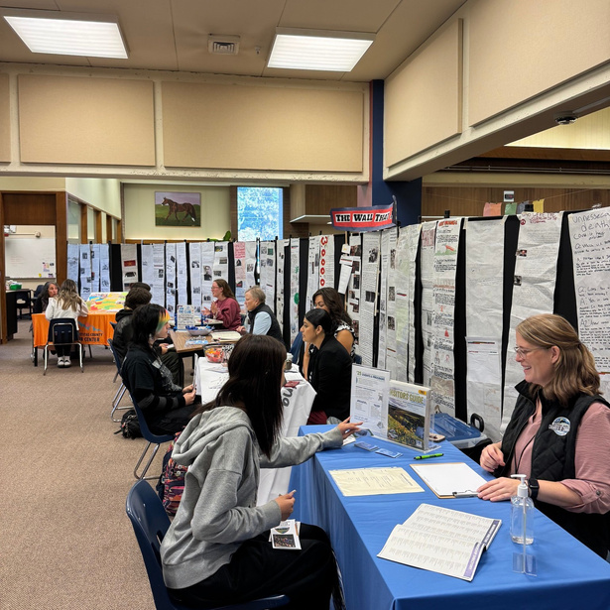
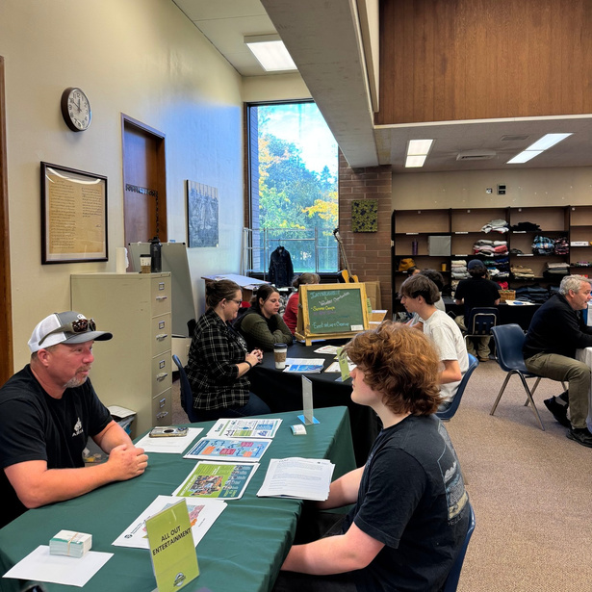
2025
  Internship Fair
  ELLENSBURG BIG PICTURE SCHOOL
Date: October 8, 2025
Location:
Ellensburg Big Picture School
Total Industry Tables: 17
Kittitas County Chamber of Commerce
EPIC Early Learning Center
Boys and Girls Club of Columbia Basin
Lazy F Camp and Retreat Center
Upper Kittitas County Senior Center
Rill Foods
City of Ellensburg
Ellensburg School District Print Shop
Kittitas Valley Healthcare
Cascade Electric
  Total Attendance: 35 (juniors and seniors)
Make Music Ellensburg
Gallery One
Department of Transportation
All Out Entertainment
KITTCOM 911
Puget Sound Energy Wild Horse Wind Facility
Kittitas County Search and Rescue

Slide 8
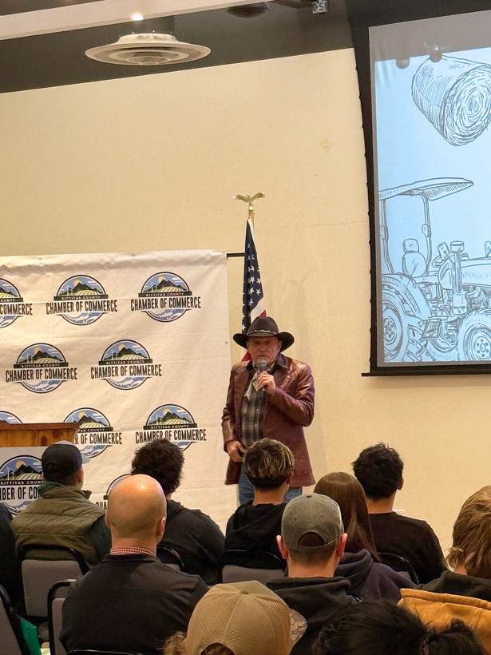

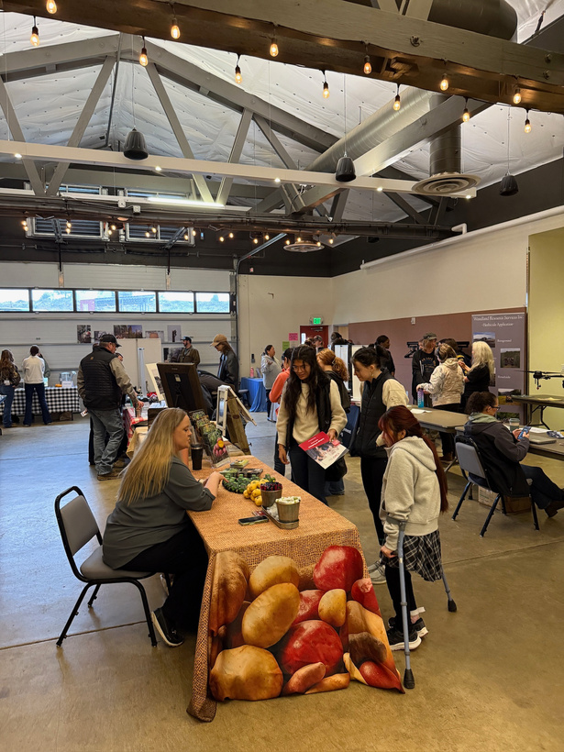
2025
  Agriculture Youth Summit
  ELLENSBURG, WA
Date: December 3, 2025
Locations:
The Armory at Kittitas Valley Event Center
Central Washington Equine Hospital
Welcome Message: 13th District Representative Tom Dent
Total Industry Speakers: 2
Joe Rotter, Red’s Fly Shop
Damon Roberts, Department of Ecology
Total Trade Show Booths: 19
Lunch Keynote: Washington State Potato Commission
Total Students: EHS 37, Thorp 19, Kittitas 3, Cle Elum 5, ECS 1 = 65
  Total Teachers/Advisors: 10 | Total Attendees: 75

Slide 9
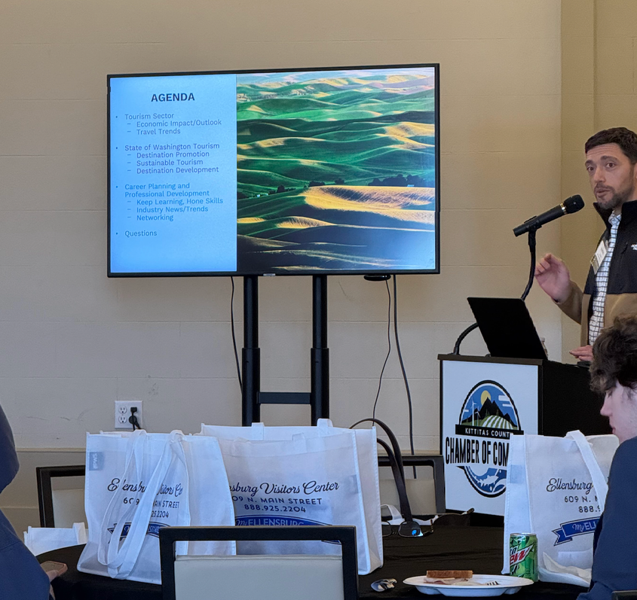
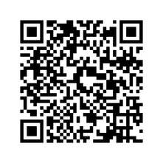
2026
  Hospitality and Tourism Youth Summit
  ELLENSBURG, WA
Date: February 25, 2026
Locations:
Kittitas County Historical Museum
Gallery One
Unity Park
The Ridge Encore
Gard Vintners
Total Industry Speakers: 15
Total Attendance: 70
Breakdown of Attendees:
Ellensburg = 41, Thorp = 19, Cle Elum/Roslyn = 10, 6 Adult Chaperones
Lunch Keynote:
Suncadia Resort - Kasey Scott | Tate Creative - Jessica Tate

Slide 10
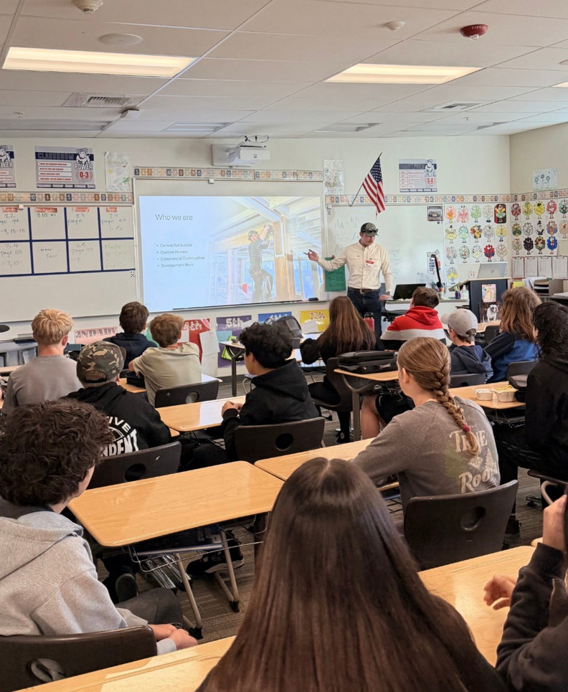
2026
  Career Fair
  ELLENSBURG, WA
Date: April 8
Time: 8:00 - 10:30 a.m.
Location: Ellensburg Morgan Middle School
Participation: 23 Guest speakers | 150+ 8th Graders
  Represented Industries: Agriculture, Arts/Design, Beauty Services, Construction/Trades, Financial Services, First Responders, Healthcare/Human Services, Hospitality, Management/Entrepreneurship, Marketing and Sales, Public Service and Safety, STEM, Supply Chain

Slide 11
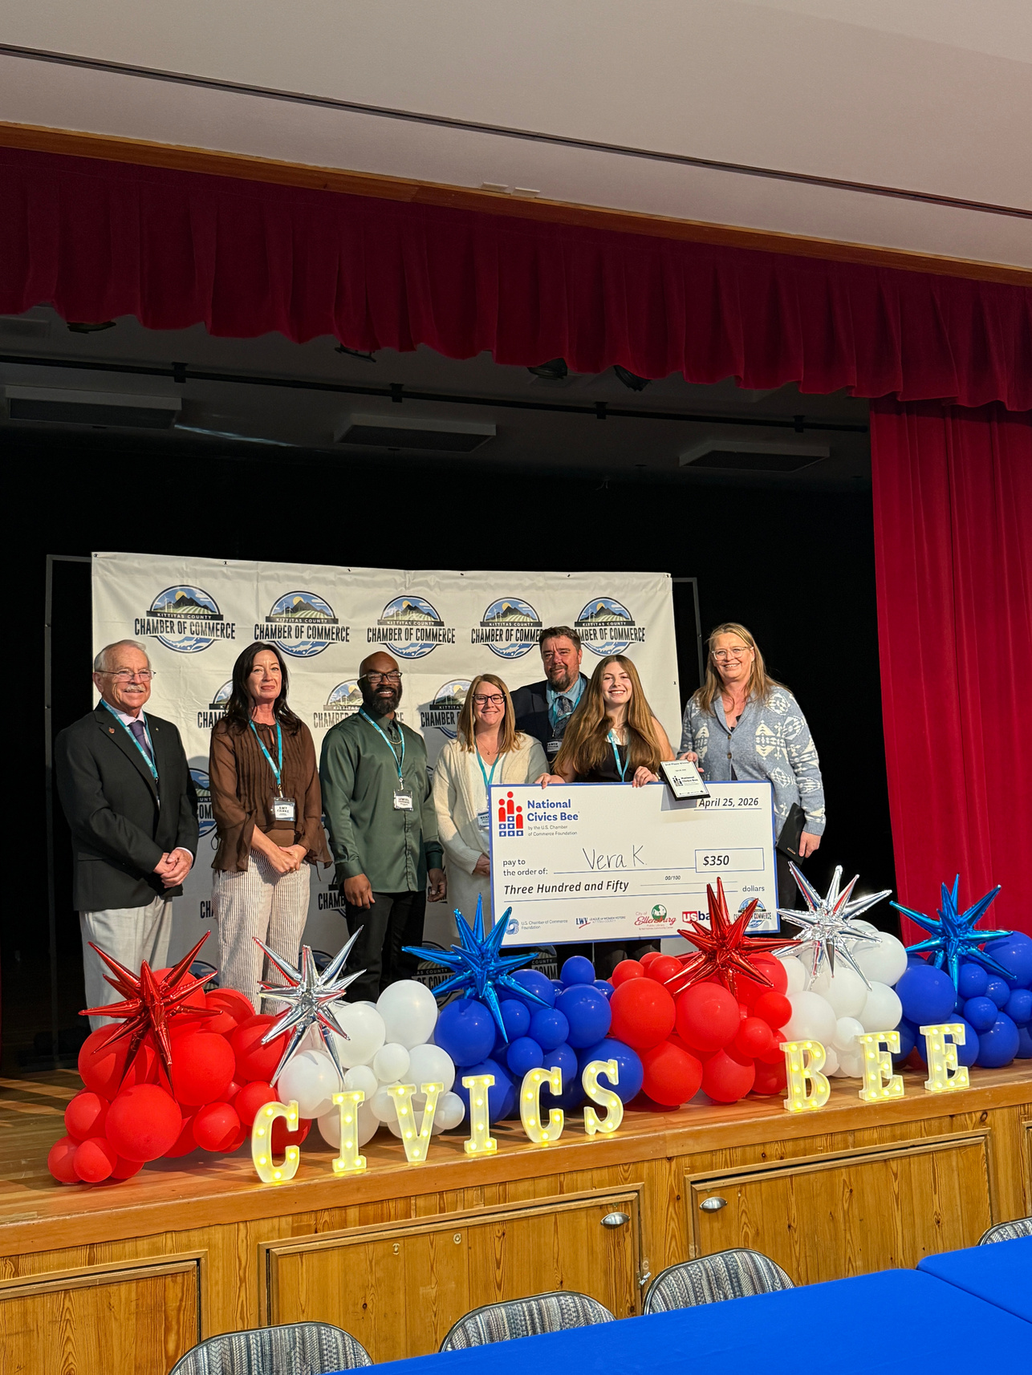
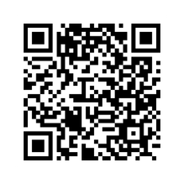

2026
  National Civics Bee Regional Competition
  ELLENSBURG, WA
Date: April 25, 2026
Locations:
Hal Holmes Community Center
Welcome Message: 13th District State Senator Judy Warnick and Representative Tom Dent
Attendees: 6-8th Graders
Sponsors: City of Ellensburg and US Bank Ellensburg
Essay Submissions: 90
Competitors: 18
Breakdown of competitors:
Selah: 7th - 10 students, Ellensburg: 6th - 1 student | 7th - 1 student | 8th - 3 students, Spokane: 8th - 2 students, Kittitas: 8th - 1 student
Learn More

Slide 12
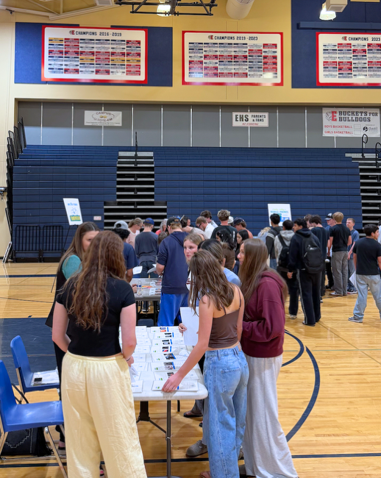
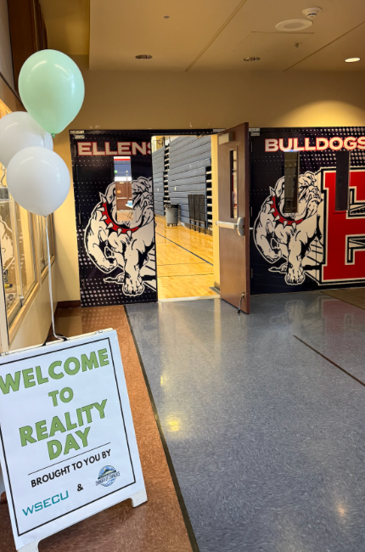
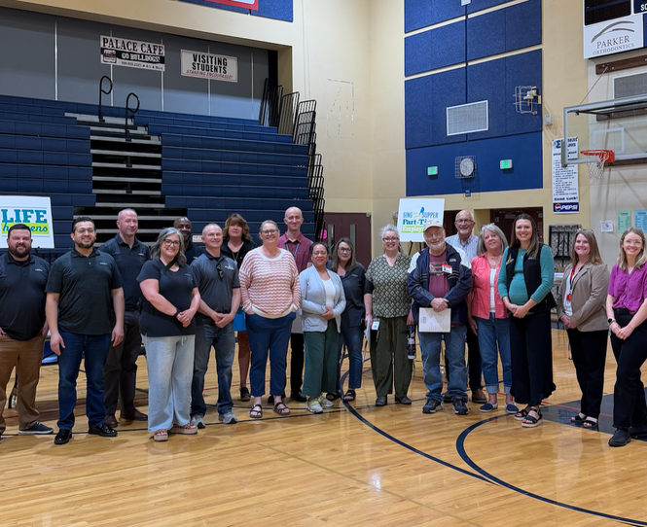
2026
  Reality Day
  ELLENSBURG, WA
Date: May 6, 2026
Time: 9:00 a.m.-1:00 p.m.
Location:
Ellensburg High School
School Participation:
Cle Elum/Roslyn Swiftwater Learning - 4
Ellensburg High School - 88
Thorp School District - 16
Produced by: WSECU and Kittitas County Chamber of Commerce
Business Participation:
  19 Volunteers from various industries

Slide 13

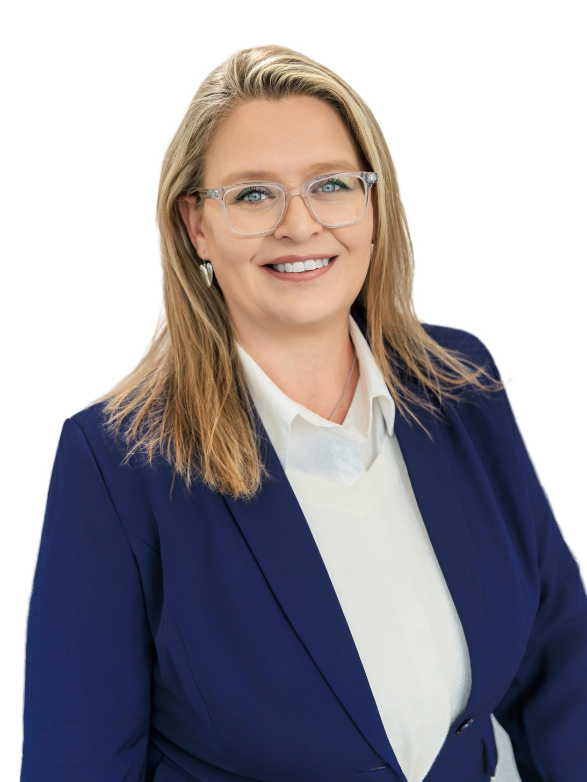
THANK YOU!
  Visit us at: kittitascountychamber.com
Amy McGuffin
CEO/President
  amy@kittitascountychamber.com

