Slide 1

The 2026 Outlook: An update from the U.S. Chamber
WCCE Annual Conference
June 5, 2026

Slide 2

Chris Eyler, Vice President, Northwest Region
ceyler@uschamber.com
206-305-0576
Alaska, Idaho, Montana, Oregon, Washington, & Wyoming
Katelyn Harrison, Manager
kharrison@uschamber.com
208-970-6232

Slide 3
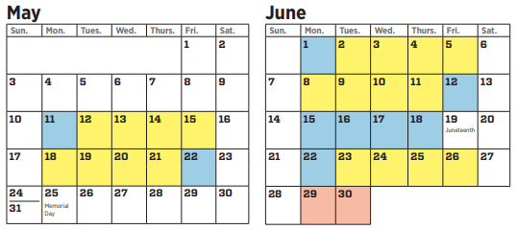
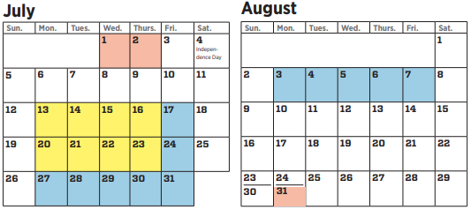
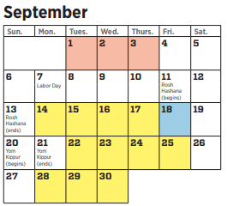
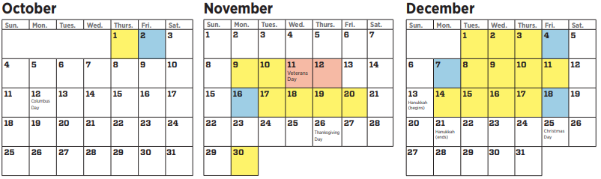

Slide 4
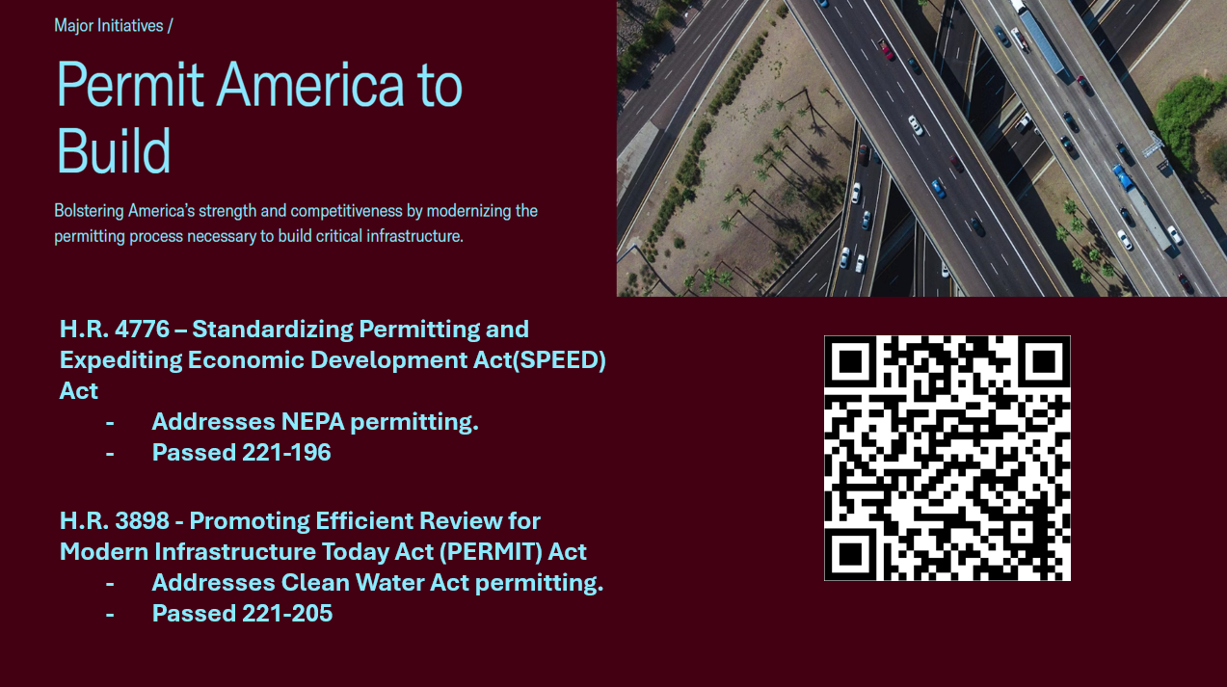

Slide 5
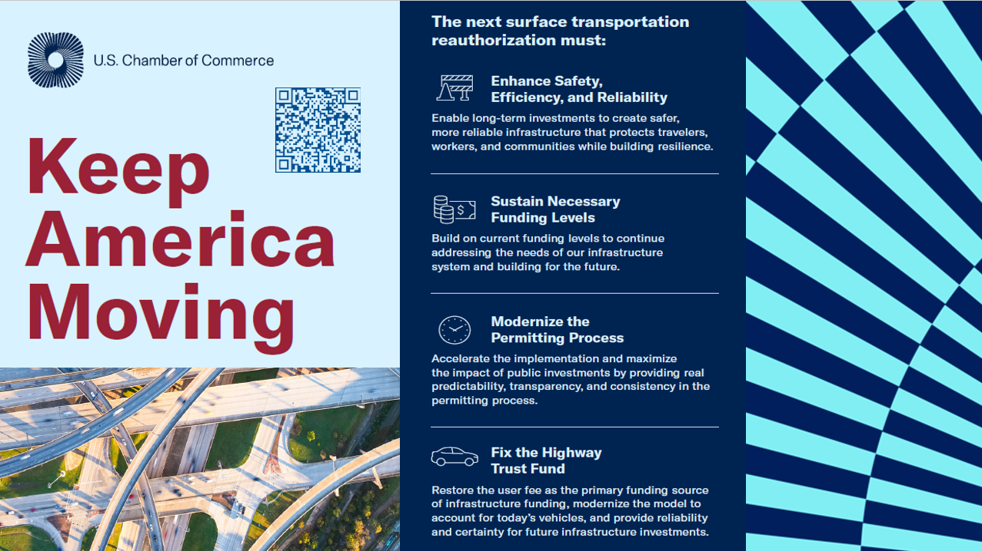

Slide 6
2026 Coalition Letters
Permitting Reform – February 22, 2026
Prove It Act – May 4, 2026
Boeing 777F Petition – May 7, 2026
Immigration Reform – Late Spring 2026
Secure Data Act – Late Spring 2026
Faster Labor Contracts Act – Late Spring 2026

Slide 7


Slide 8
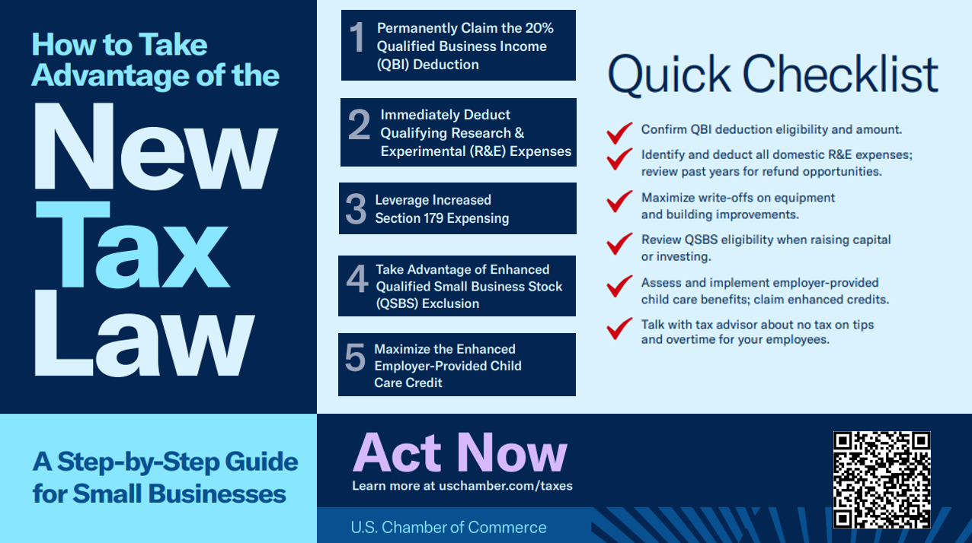

Slide 9

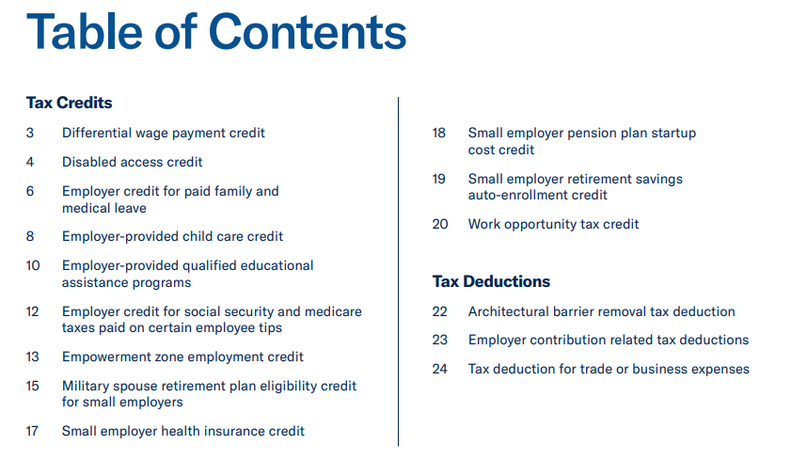
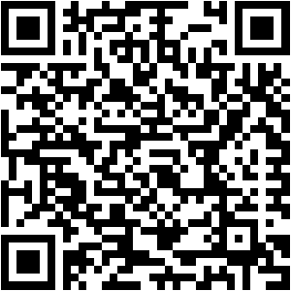
Download the 2025 Tax Guide

Slide 10
2026 Mid-Term Congressional Elections
U.S. House – 217 R - 212 D
U.S. Senate – 53 R - 47 D
Key NW Races to Watch
WA-03 – Glusenkamp Perez (D-WA-03)
WA-04 – Open
MT-01 – Open
MT Senate – Open
WY House – Open
WY Senate – Open
AK Senate – Sullivan (R-AK)

Slide 11
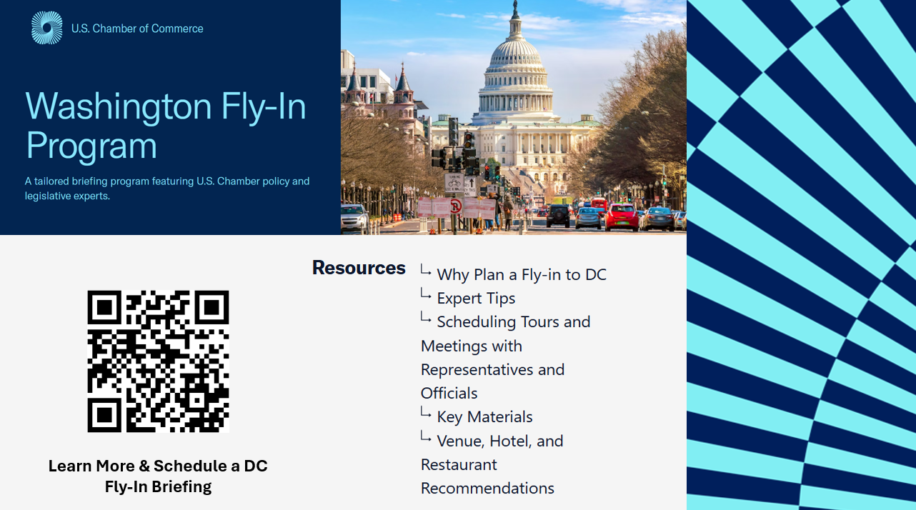

Slide 12


Slide 13

THANK YOU!
Chris Eyler
Vice President, Northwest Region
U.S. Chamber of Commerce
206-305-0576
ceyler@uschamber.com

