Slide 1
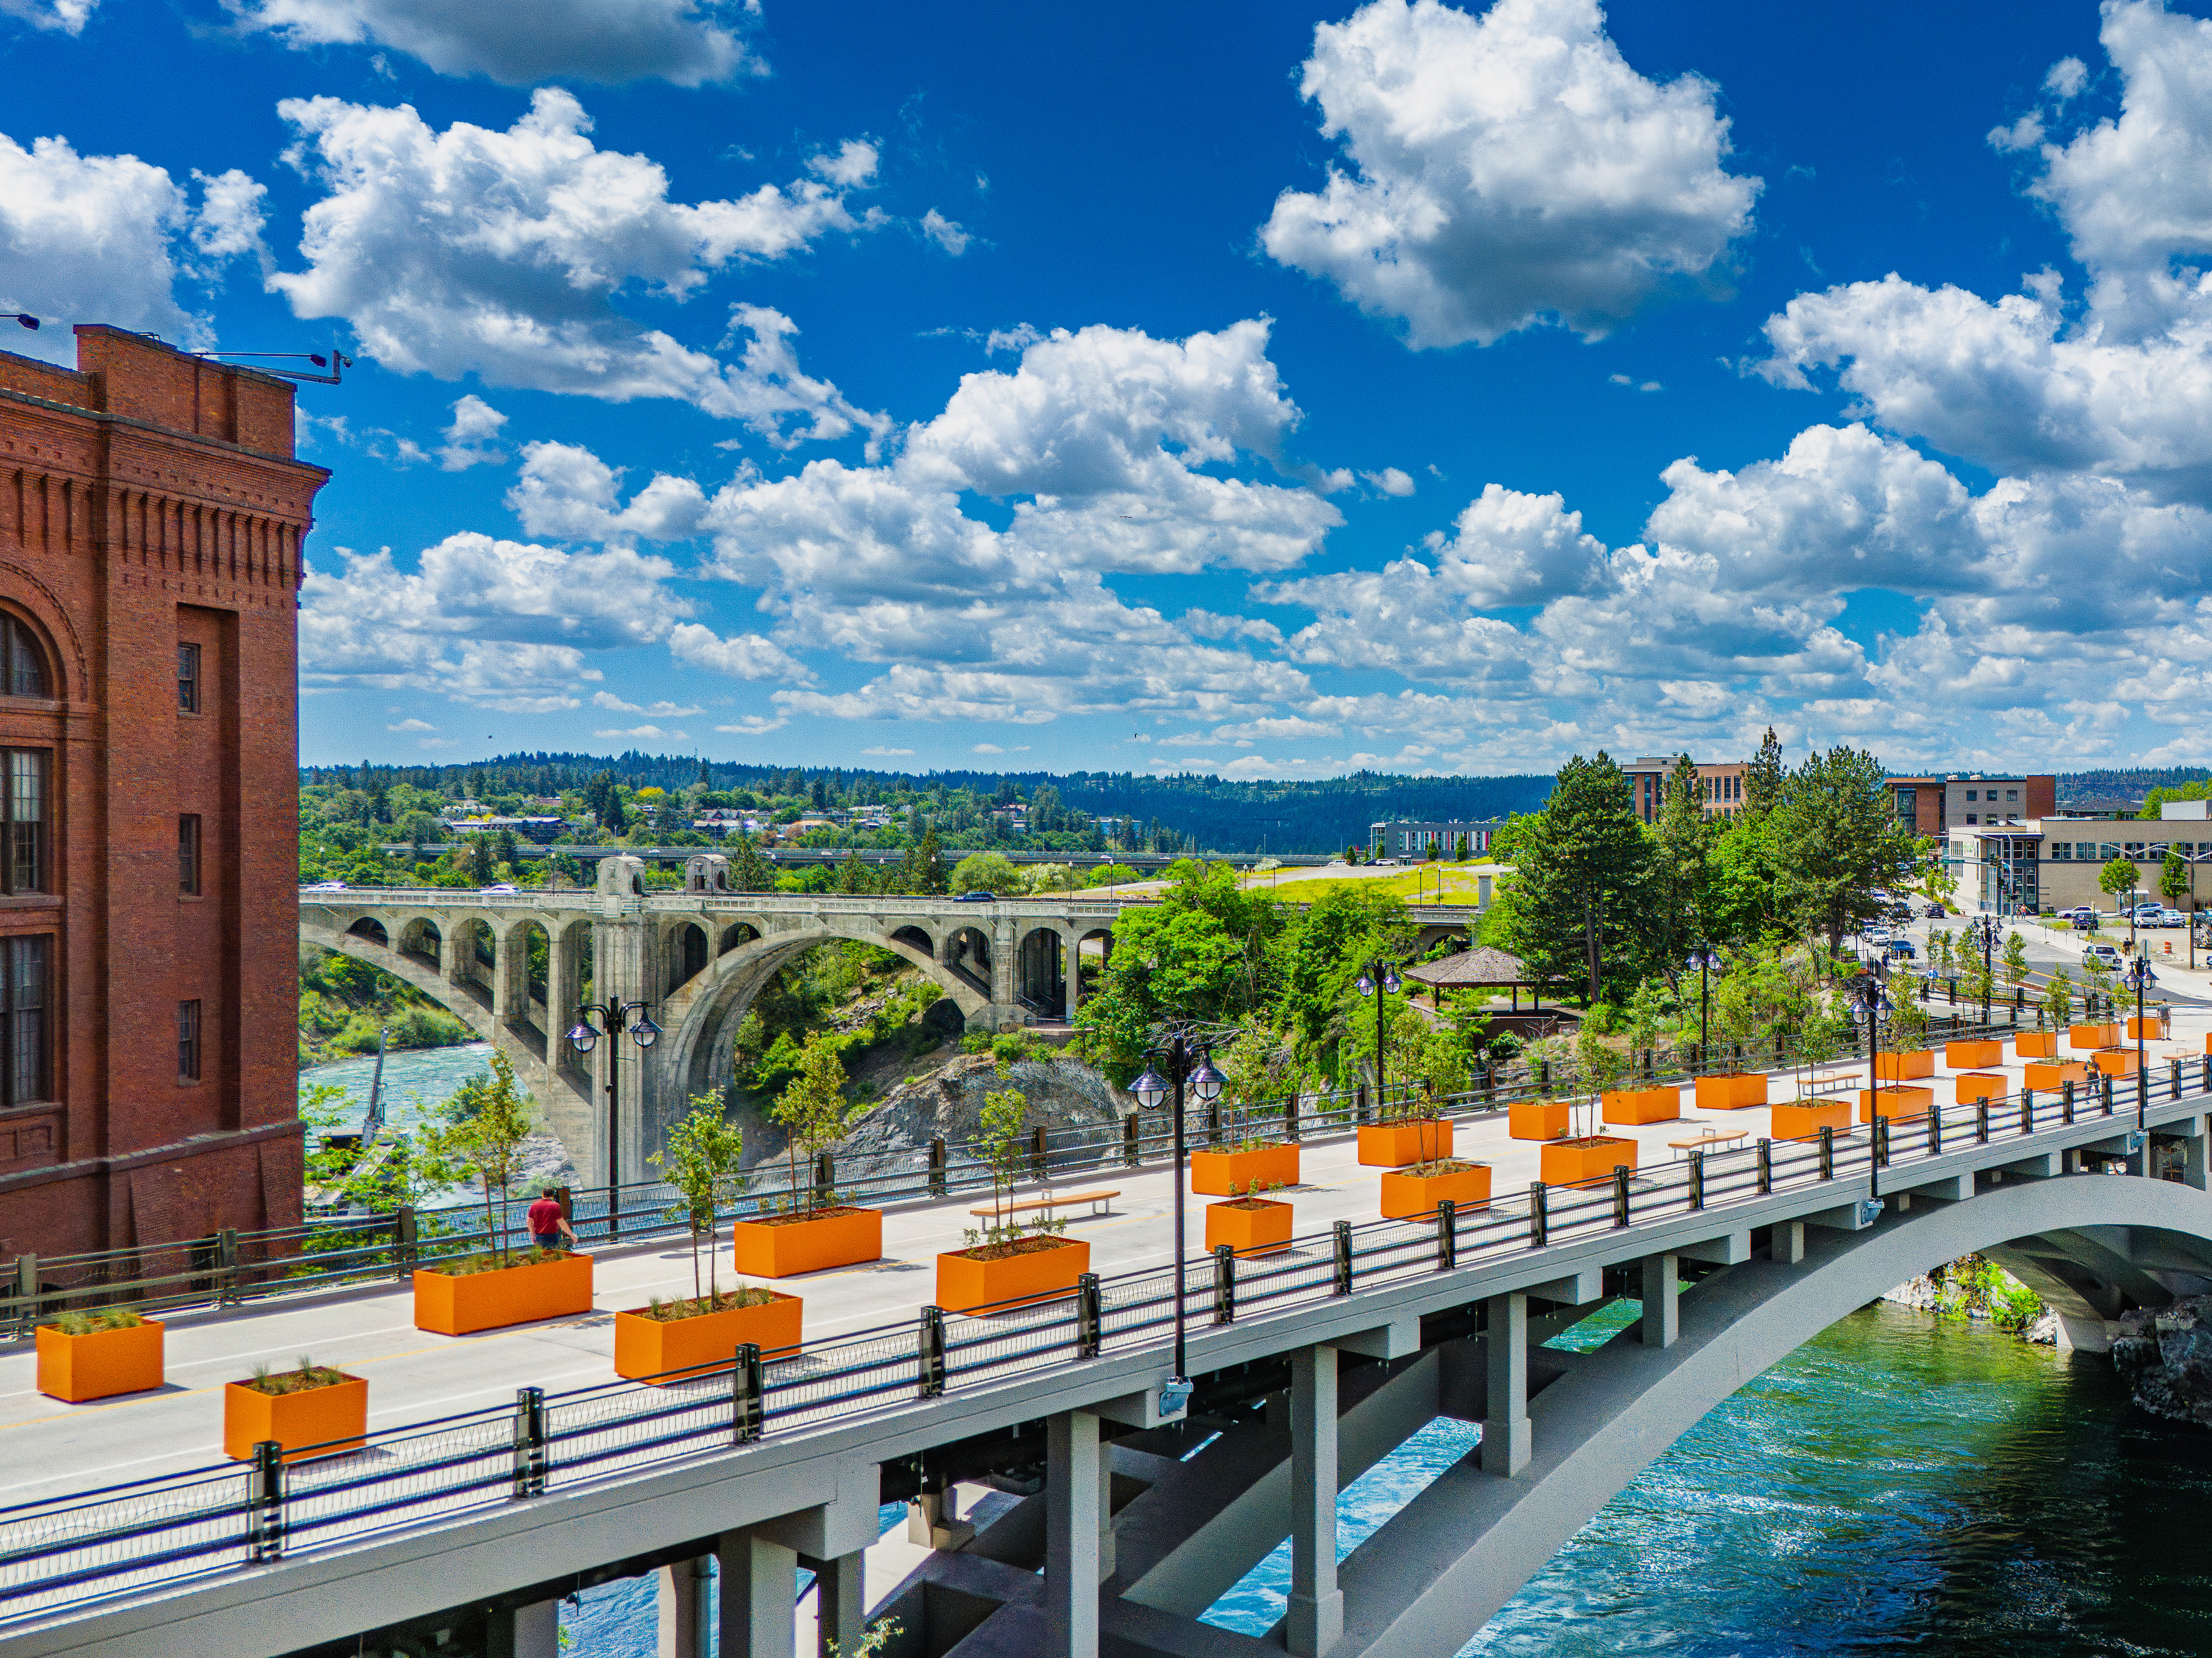


Building a Regional Investment Campaign Beyond Membership Dues
Lance Beck, Chief Strategy Officer
Greater Spokane Inc.

Slide 2

The Challenge
Traditional chamber revenue funds operations
Communities increasingly expect:
Economic Development
Workforce Development
Regional Research
Strategic Convening
Question: How do you fund transformational work when dues are designed to fund operations?

Slide 3
Before We Asked for a Dollar
1. Create a Five-Year Regional Vision
2. Conduct an Independent Feasibility Study
3. Listen to Community Leaders
4. Refine the Strategy
5. Launch the Campaign
Key Takeaway: We spent nearly as much time validating the idea as we did fundraising.

Slide 4
What We Learned
Investors told us:
  Focus on measurable outcomes
  Demonstrate ROI
  Show regional impact
  Avoid duplication
People don't invest in activities.
They invest in outcomes.

Slide 5
What Believe Spokane Became
A Five-Year Regional Investment Campaign supporting:
Economic Development
Workforce Alignment
Regional Research
Community Leadership
Different than membership, sponsorships, annual fundraising, or grants.

Slide 6
Five Lessons for Chamber Executives
Start With Strategy, Not Fundraising
Validate Before You Ask
Sell Outcomes, Not Programs
Create Investor Ownership
Think Beyond Membership
Closing Thought: A compelling vision can unlock resources far beyond traditional chamber revenue streams.

